Slide 1
Election briefing: NHS and social care funding
Three unavoidable challenges
May 2017

Slide 2
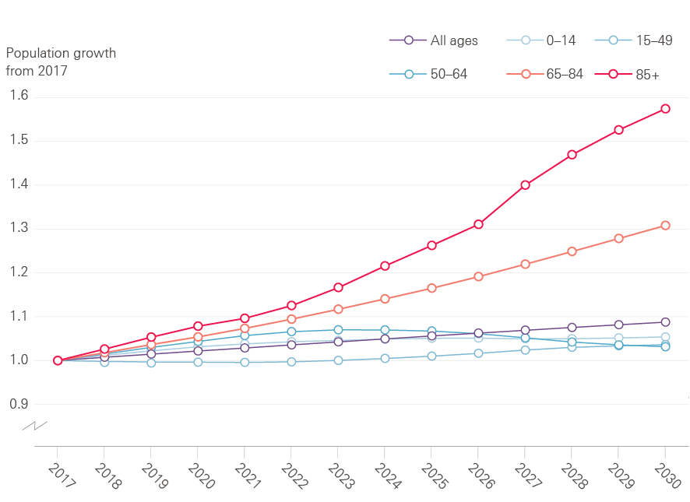
Growth in English population by age group
Source: ONS population projections, 2014
Notes:
Figure 1

Slide 3
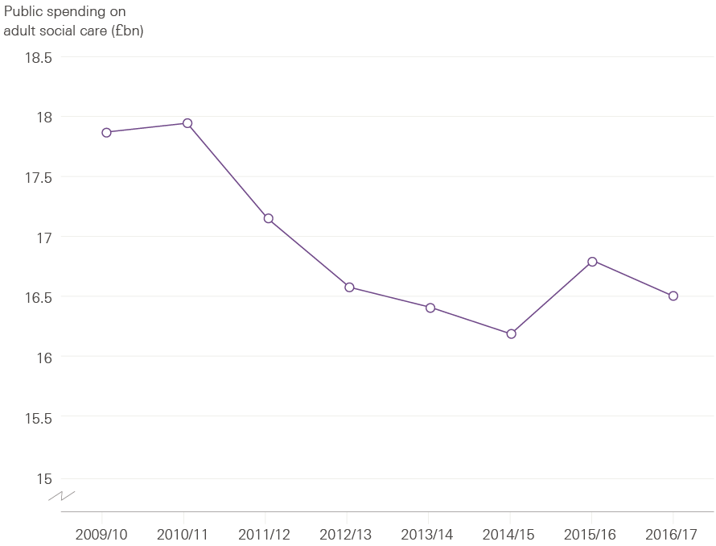
Public spending on adult social care in England 2009/10 to 2016/17 (2017/18 prices)
Source: NHS Digital personal social services expenditure and unit costs; DCLG local authority revenue expenditure and financing.
Notes:
Figure 2

Slide 4
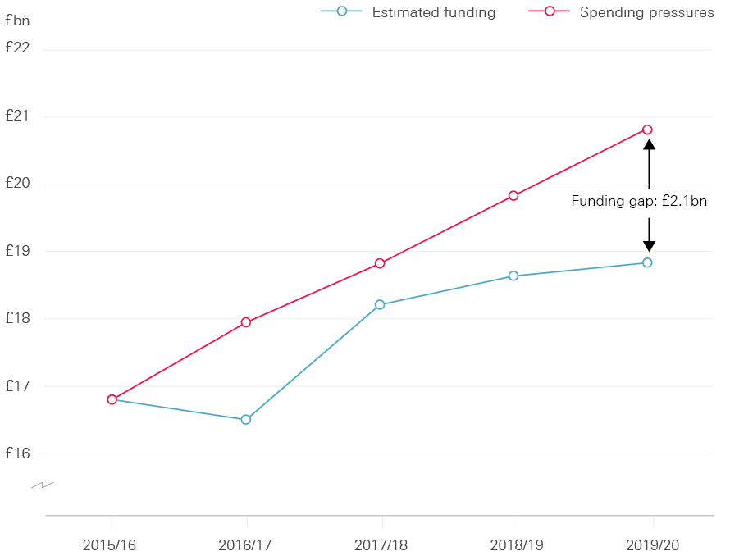
Social care funding gap, 2015/16–2019/20 Gap between estimated public spending on adult social care and funding pressures (2017/18 prices)
Source: Health Foundation analysis based on multiple sources.
Notes:
Figure 3

Slide 5
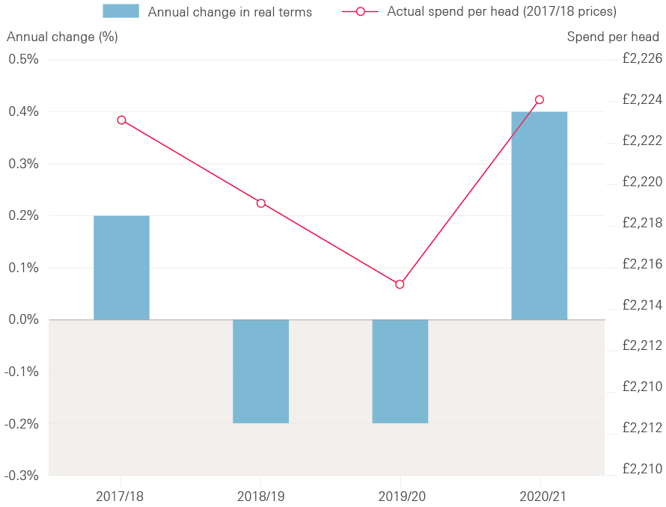
Changes in total NHS spend per head Annual change and actual spend per head for 2017/18 to 2020/21 (2017/18 prices)
Source: Department of Health Annual Accounts 2015/16
Notes:
Figure 4

Slide 6
Health care spending in England, 2014/15 to 2020/21
 | 2014/15 Outturn | 2015/16 Outturn | 2016/17 Plan | 2017/18 Plan | 2018/19 Plan | 2019/20 Plan | 2020/21 Plan | Change (£m / %), 2014/15 – 2020/21 | Change (£m / %), 2015/16 – 2020/21
Total Department of Health expenditure limit, cash terms (£m) | £113,345 | £117,594 | £120,611 | £123,688 | £126,343 | £129,143 | £133,051 | £19,706 | £15,457
Total Department of Health expenditure limit, 2017/18 prices (£m) | £118,275 | £121,874 | £122,576 | £123,688 | £124,398 | £125,078 | £126,482 | £8,207 | £4,608
Change in real terms | – | 3.0% | 0.6% | 0.9% | 0.6% | 0.5% | 1.1% | 1.1% | 0.7%
NHS England, cash terms (£m) | £97,994 | £100,685 | £106,800 | £110,200 | £112,700 | £115,800 | £119,900 | £21,906 | £19,215
NHS England, 2017/18 prices (£m) | £102,257 | £104,350 | £108,540 | £110,200 | £110,965 | £112,156 | £113,980 | £11,723 | £9,630
Change in real terms | – | 2.0% | 4.0% | 1.5% | 0.7% | 1.1% | 1.6% | 1.8% | 1.8%
Source: Department of Health Annual report and accounts 2015/16, NHS England Annual accounts 2015/16, NHS England Board PAPER PB. 17.12.15/04
Notes:
Table 1

Slide 7
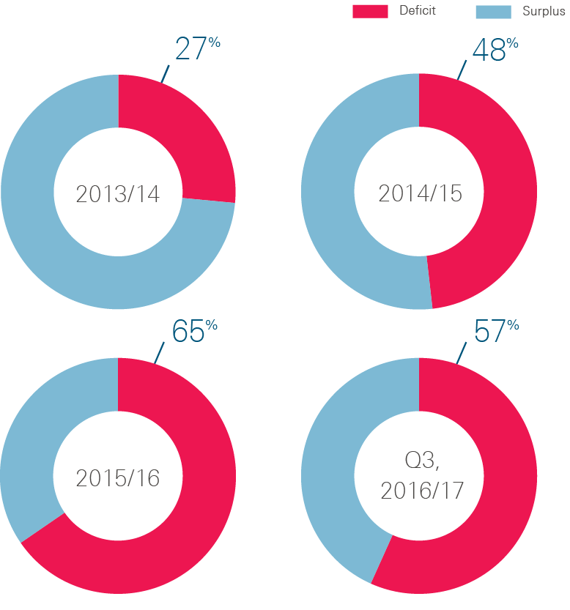
NHS providers reporting a surplus/deficit 2013/14–Q3 2016/17 (%)
Source: Health Foundation analysis of NHS Improvement data
Notes:
Figure 5:

Slide 8
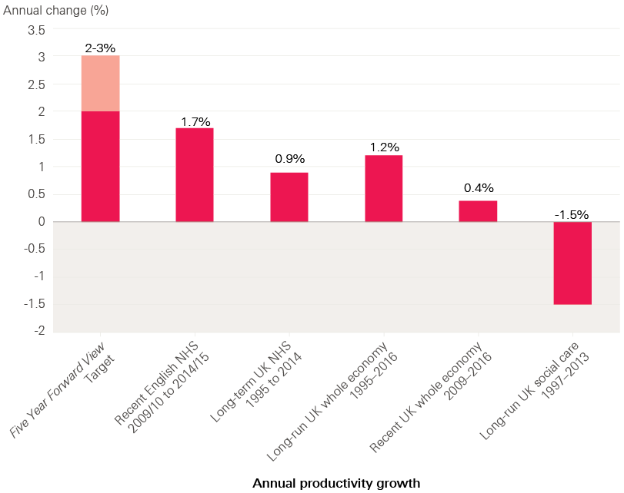
Average annual increase in productivity for NHS, social care and whole economy
Source: Health Foundation analysis based on multiple sources
Notes:
Figure 6

Slide 9
UK projections of health care and social care spending as a share of GDP
 | 2016/17 | 2021/22 | 2026/27 | 2031/32
Health | 7.3% | 6.9% | 7.6% | 8.4%
Long-term care | 1.0% | 1.1% | 1.3% | 1.4%
Combined | 8.3% | 8.0% | 8.9% | 9.8%
Additional share of GDP for health and care combined for each five-year block |  | -0.3 percentage points | 0.9 percentage points | 0.9 percentage points
Source: Office for Budget Responsibility Fiscal Sustainability Report January 2017. (Note: the long-term care projections do not include the announcements of additional funding in the spring budget 2017.)
Notes:
Table 2

Slide 10
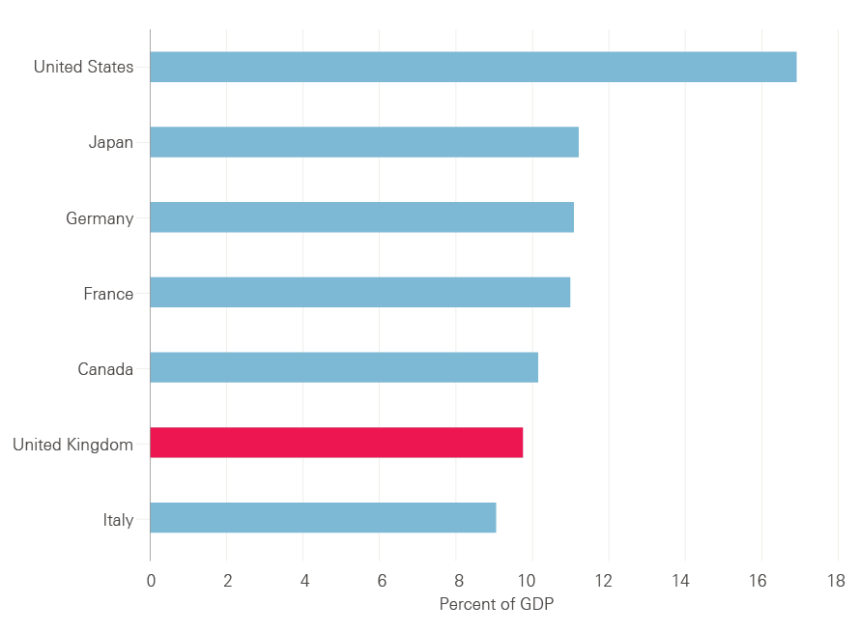
Health care spending as percentage of GDP – How the United Kingdom compared to other G7 countries in 2015
Source: OECD Health Statistics 2016, Frequently Requested Data
Notes:
Figure 8:

Slide 11
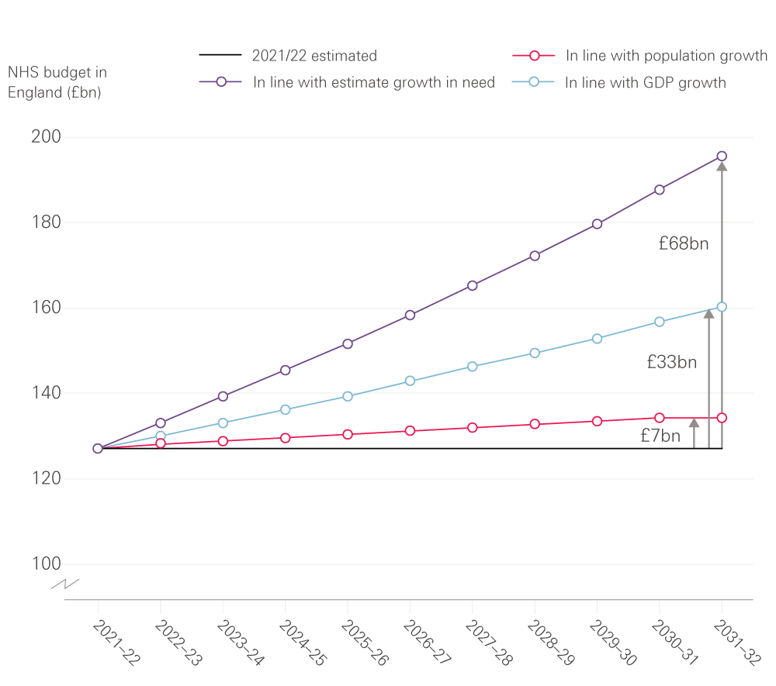
Projections of additional funding required for the NHS budget in England (2017/18 prices)
Source: Health Foundation analysis based on Office for Budget Responsibility, fiscal sustainability report 2017
Notes:
Figure 9:

Slide 12
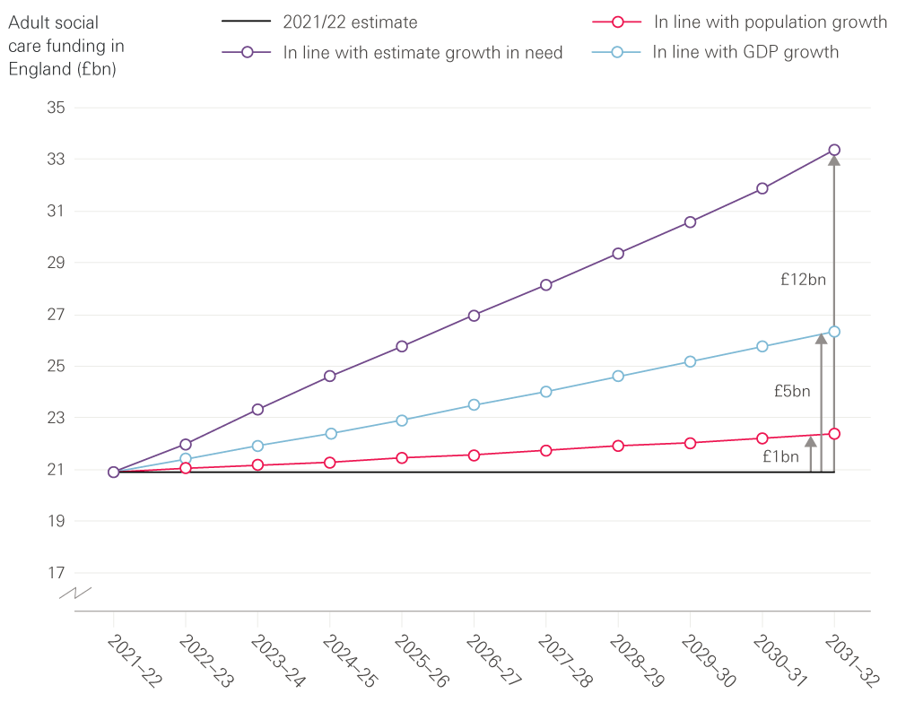
Projections of additional funding required for publicly funded adult social care (2017/18 prices)
Source: Health Foundation analysis based on Office for Budget Responsibility, fiscal sustainability report 2017
Notes:
Figure 10:

Slide 13
The Health Foundation is an independent charity committed to bringing about better health and health care for people in the UK.
We connect what works on the ground with effective policymaking and vice versa.

Slide 14
Subscribe to our email newsletter
Register for email alerts to be notified about our latest work
Follow us on Twitter, Facebook or LinkedIn

