Slide 1
Staffing matters; funding counts
Supplement: Workforce profile and trends
July 2016

Slide 2
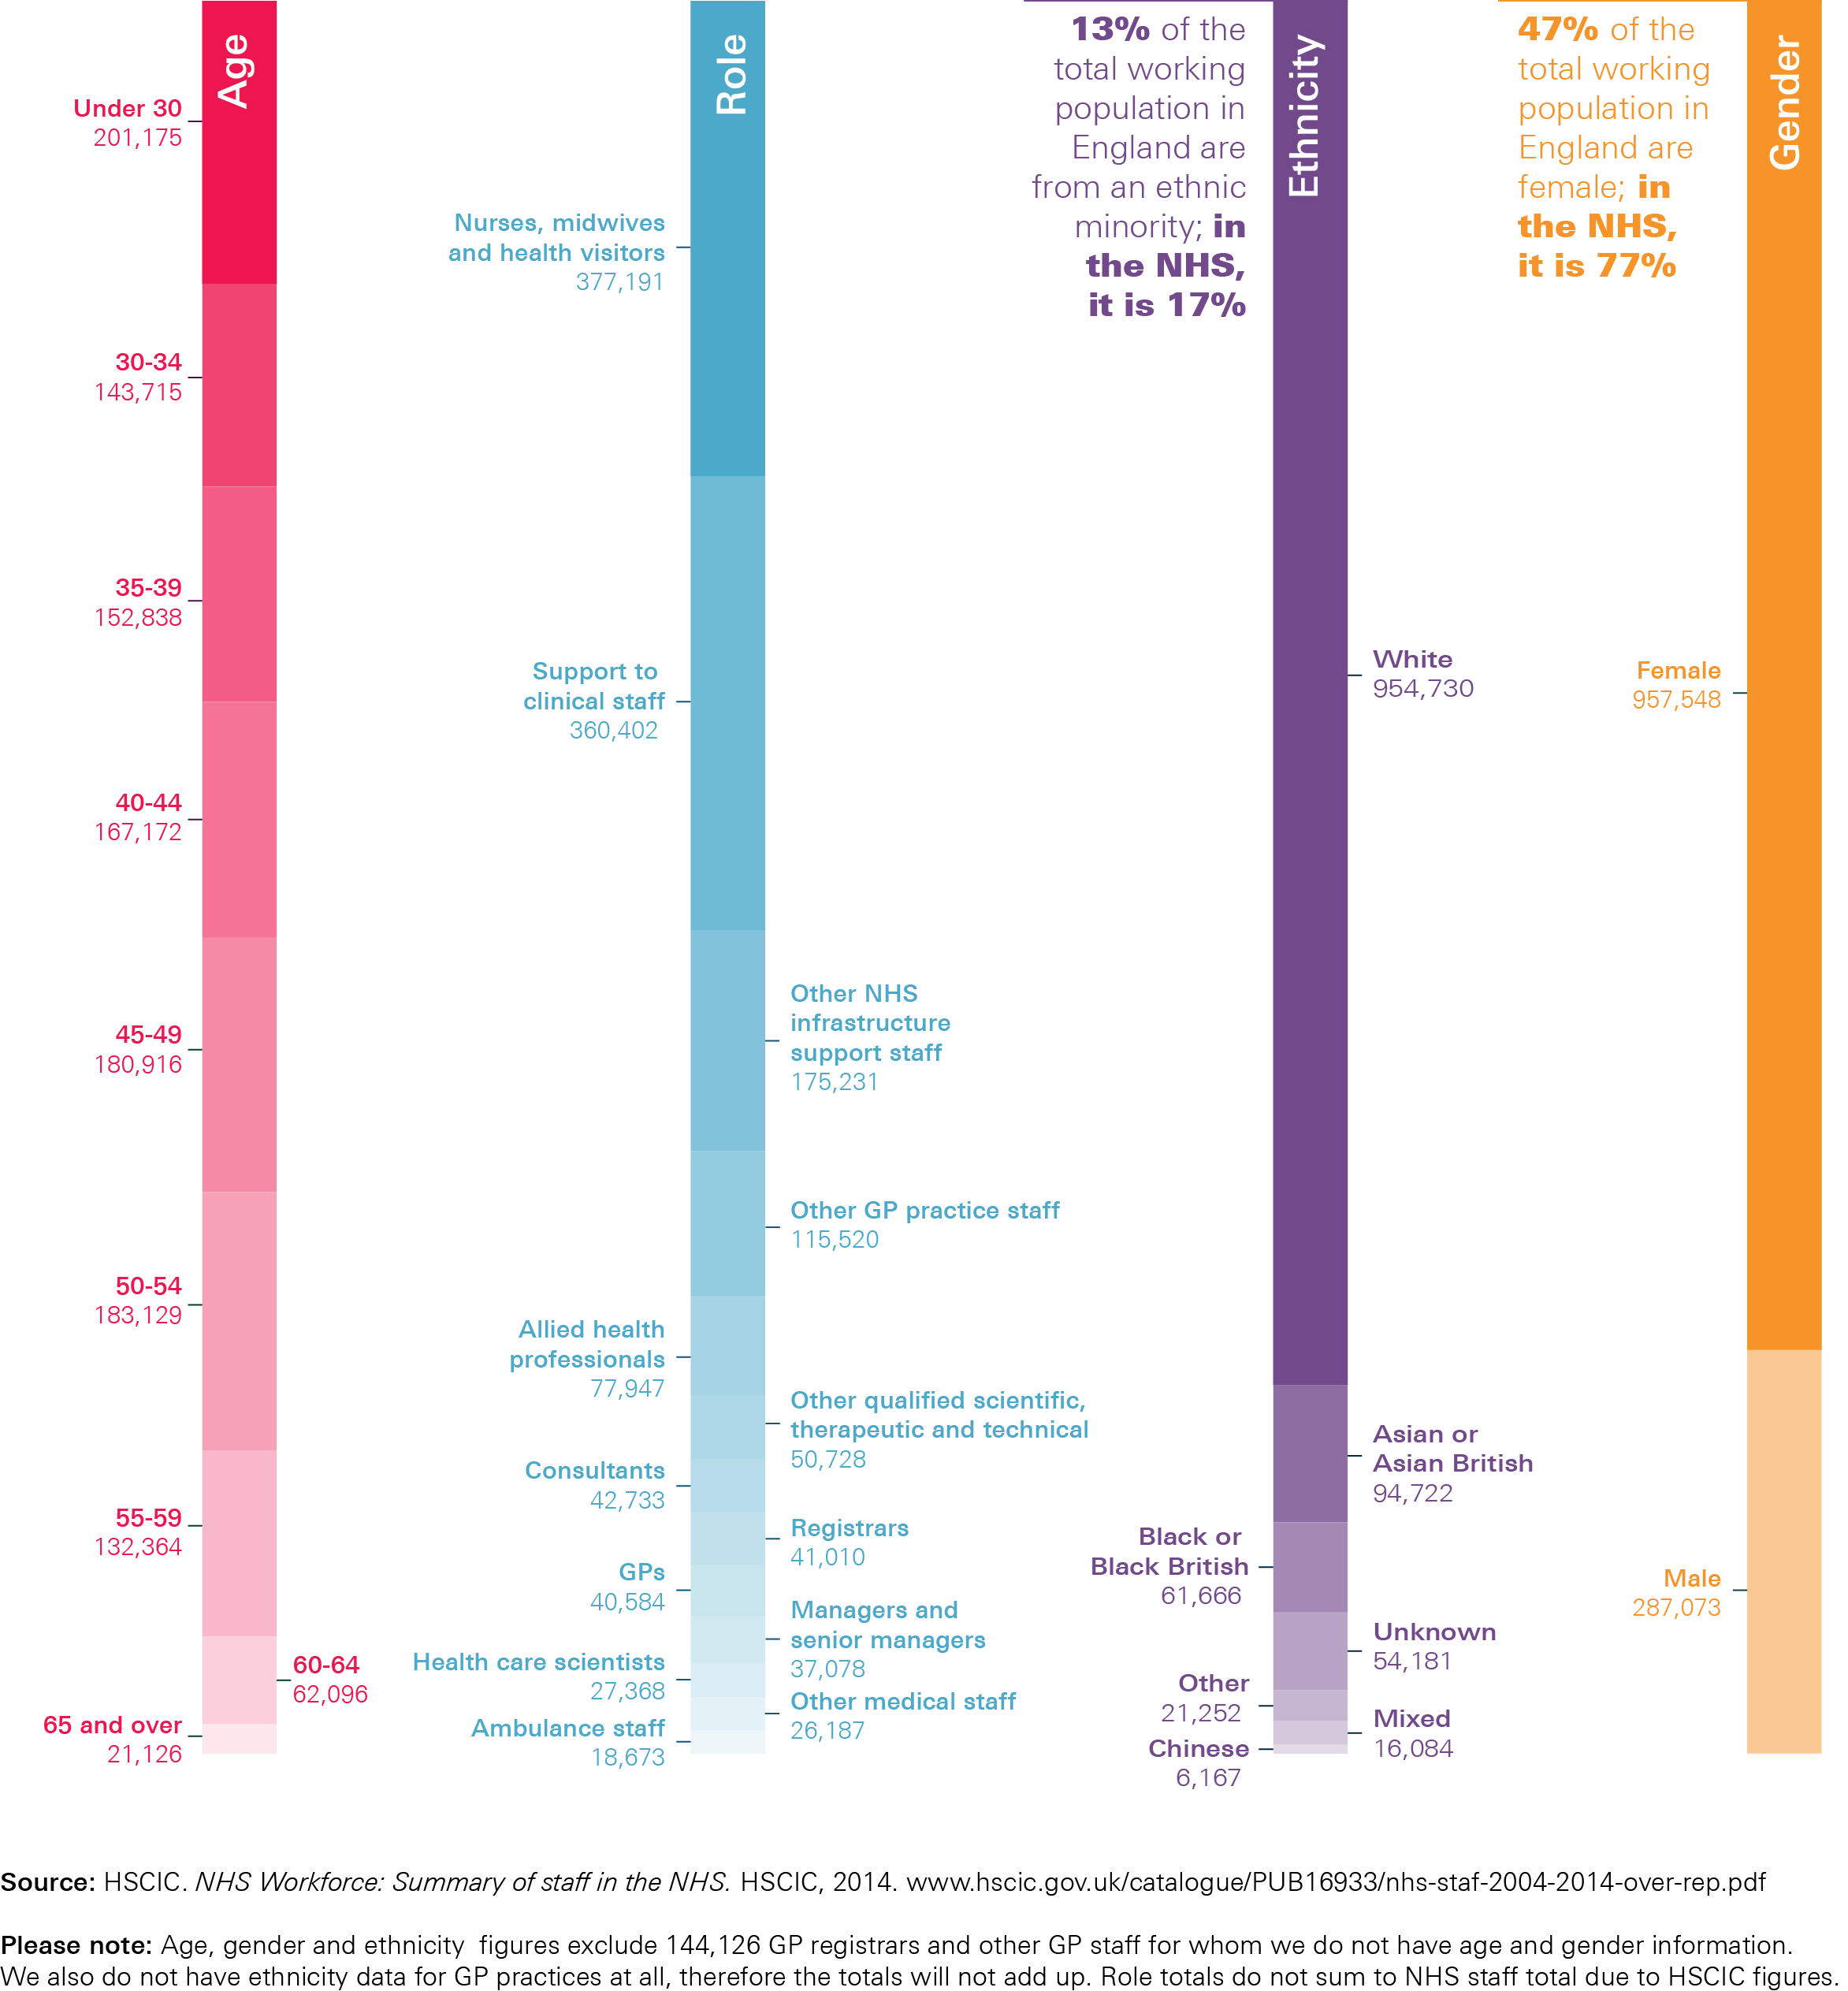
Figure A: The size, scale and diversity of the NHS workforce

Slide 3
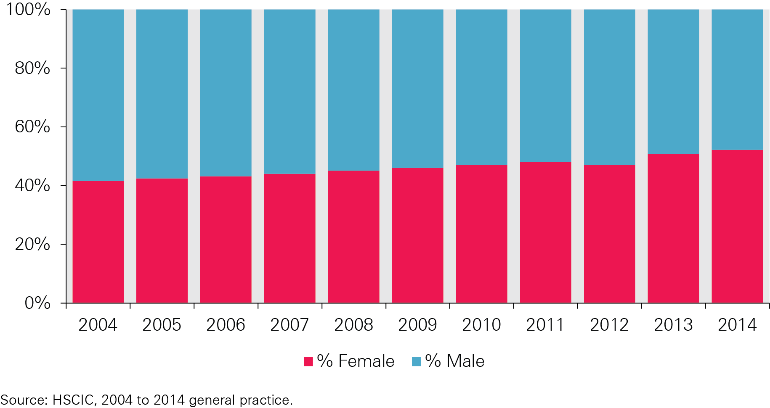
Figure B: Percentage of GPs (headcounts) by gender, 2004–14

Slide 4
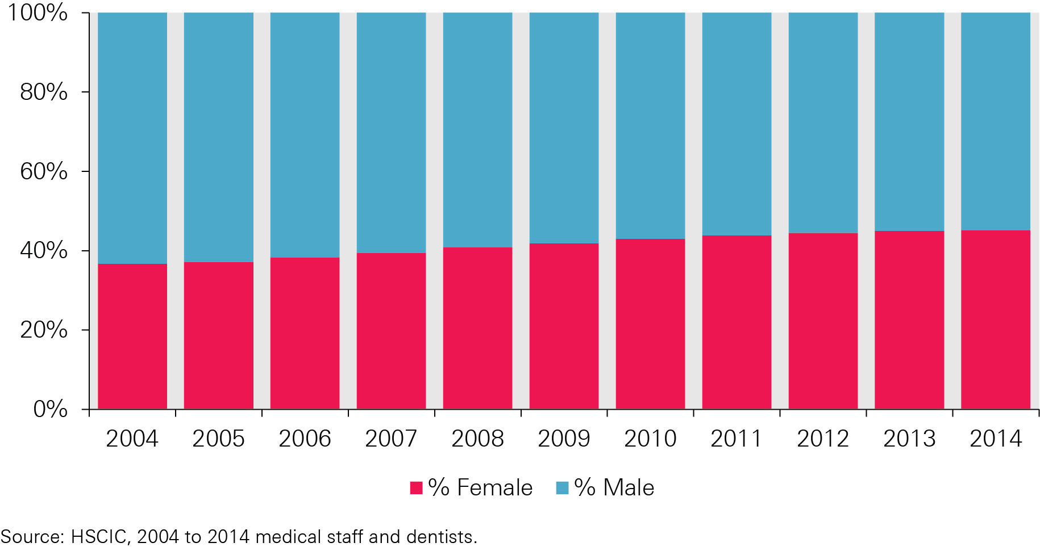
Figure C: Percentage of HCHS doctors (headcounts) by gender, 2004–14

Slide 5
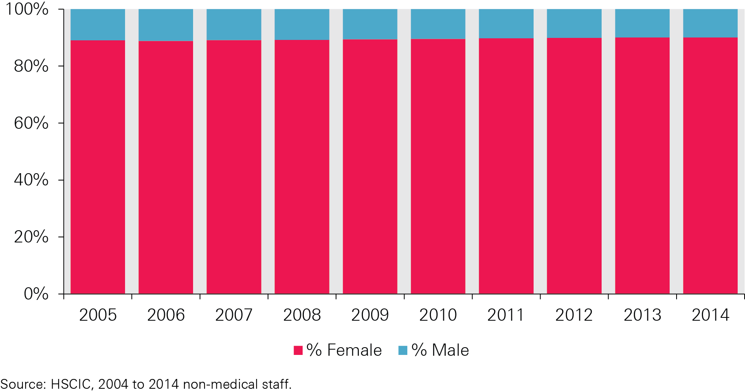
Figure D: Percentage of qualified nurses, midwives and health visitors (headcounts) by gender, 2005–14

Slide 6
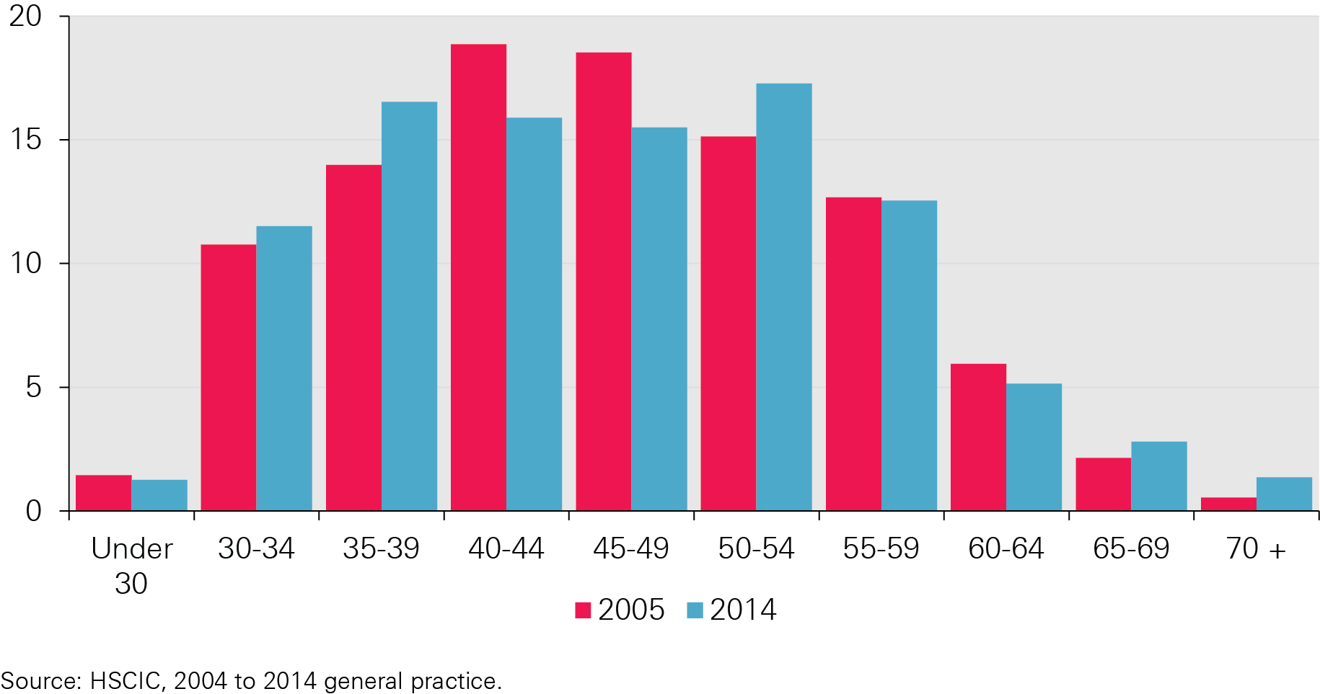
Figure E: Percentage of GPs (headcounts) by age group, 2005 and 2014

Slide 7
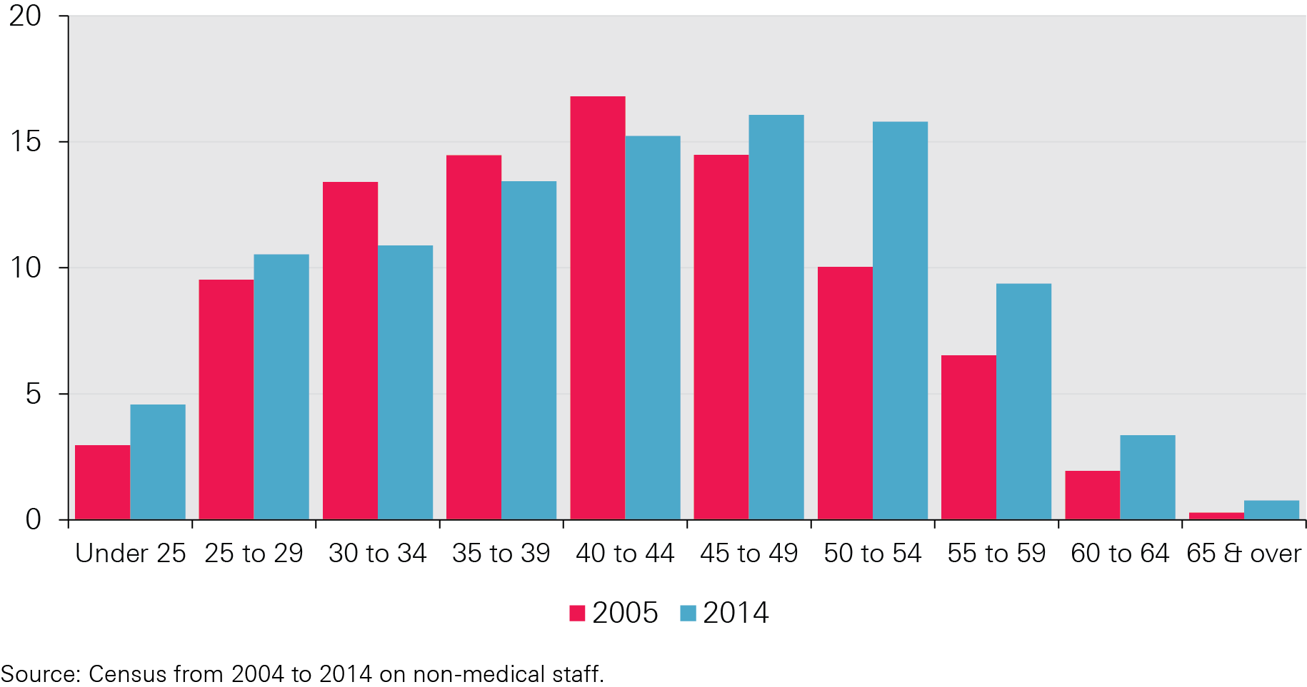
Figure F: Percentage of qualified nurses, midwives and health visitors (headcounts) by age group, 2005 and 2014

Slide 8
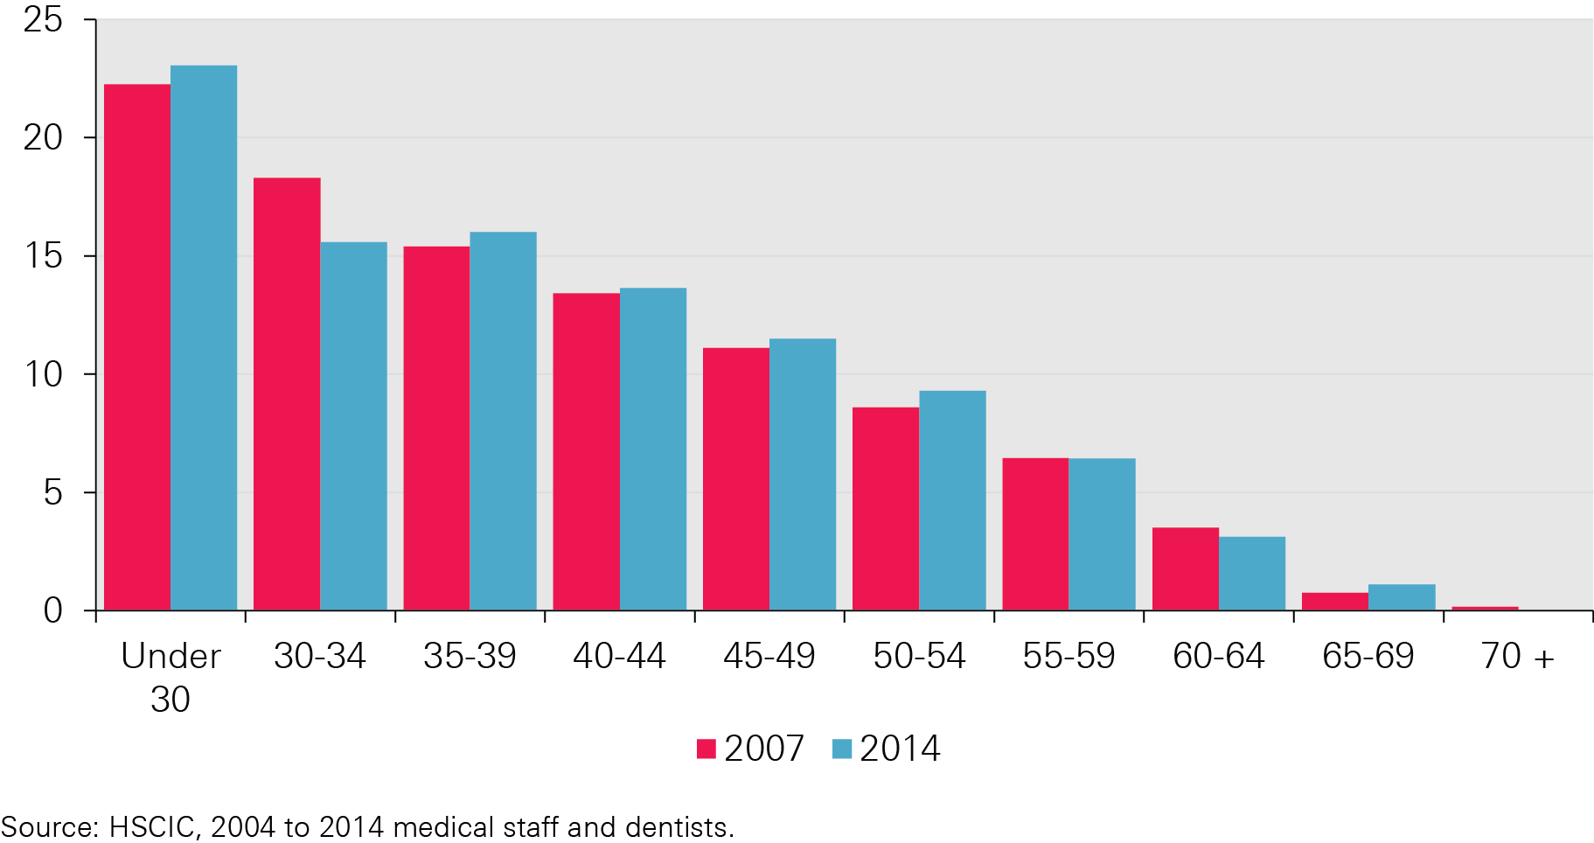
Figure G: Percentage of HCHS doctors (headcounts) by age group, 2007 and 2014

Slide 9
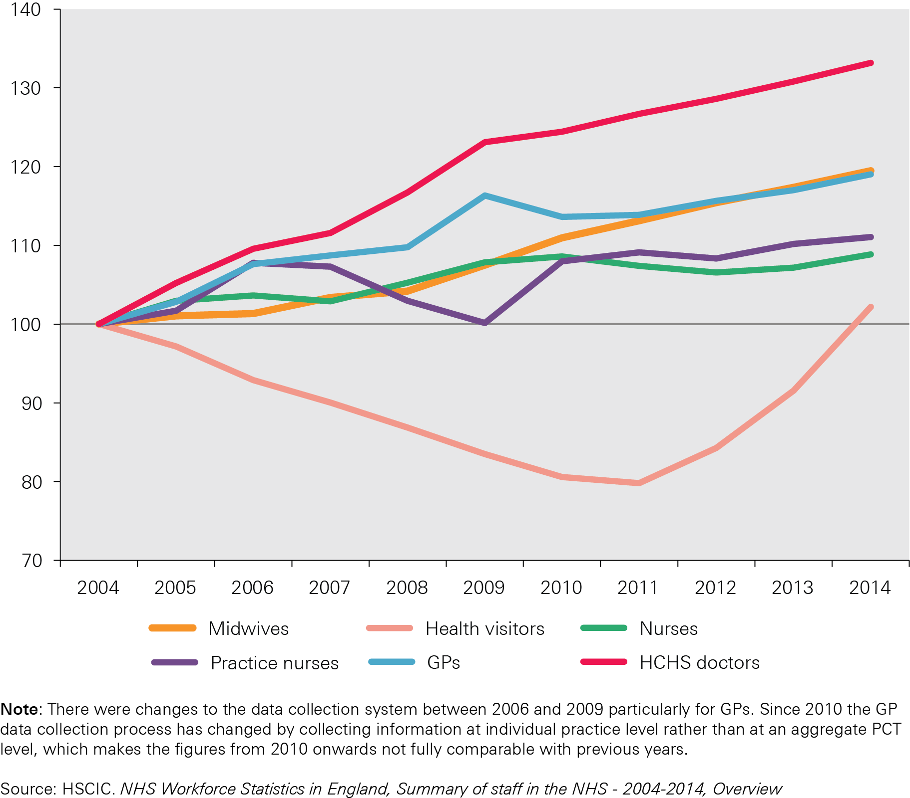
Figure H: Change in selected occupations, NHS in England, 2004–14 (FTE)

Slide 10
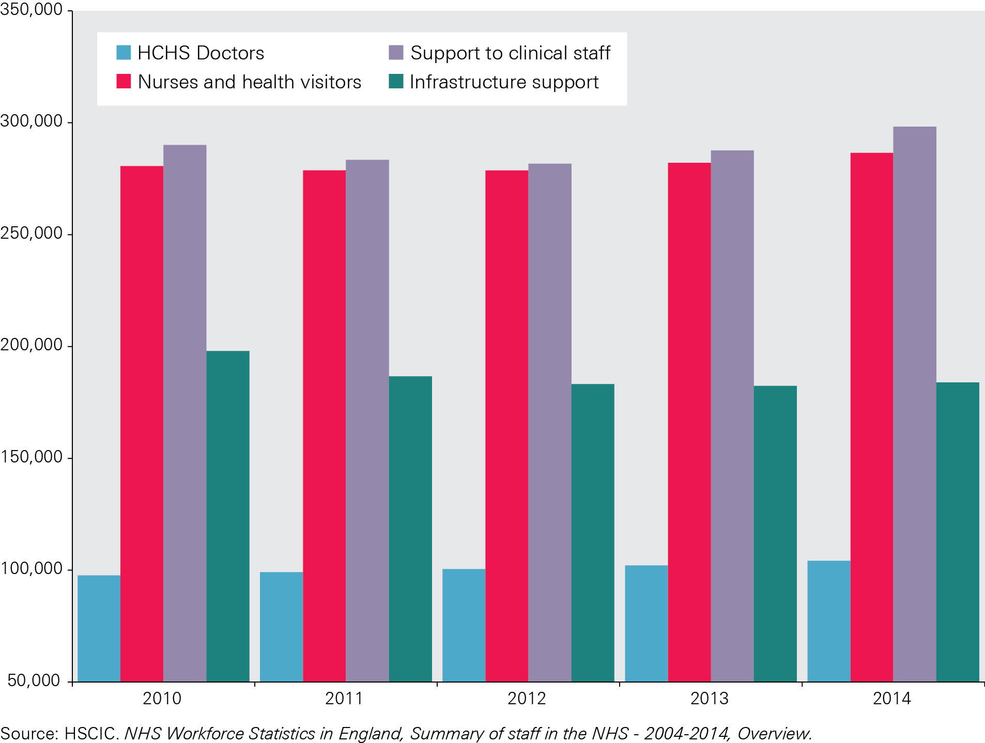
Figure I: Number of nurses employed in acute, general and elderly sectors, excluding bank and agency staff, 2010–14

Slide 11
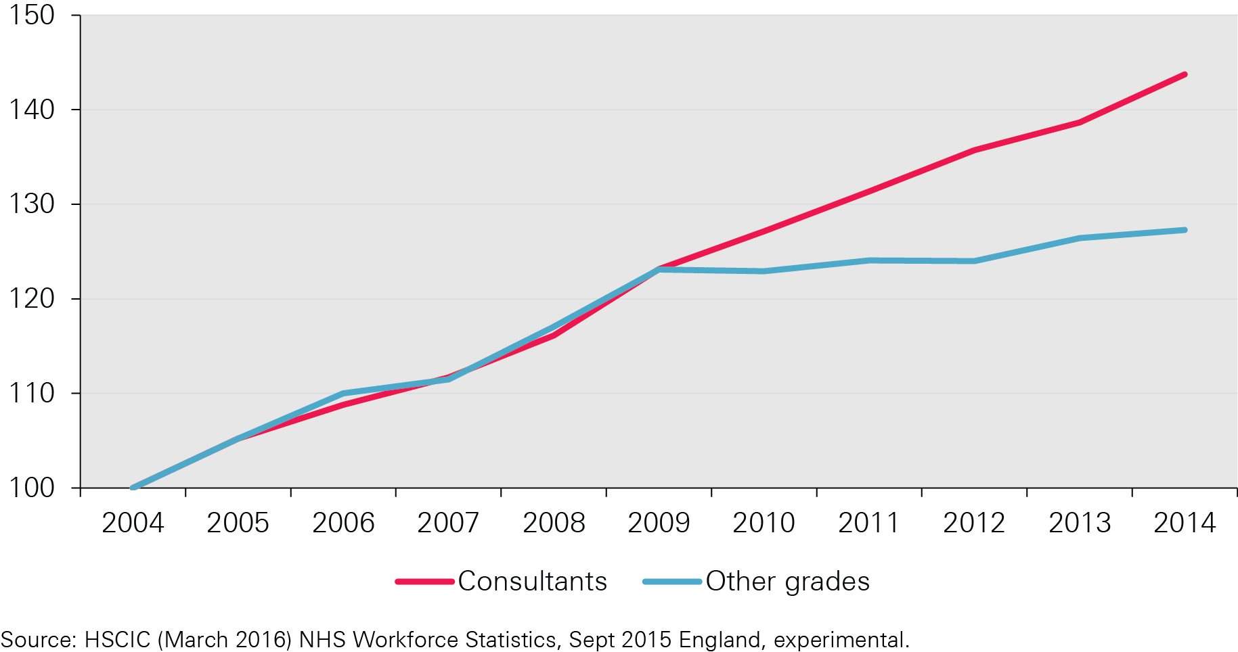
Figure J: Change in hospital consultant and other grades, NHS England, 2004/05–2014/15 (2004/05=100)

Slide 12
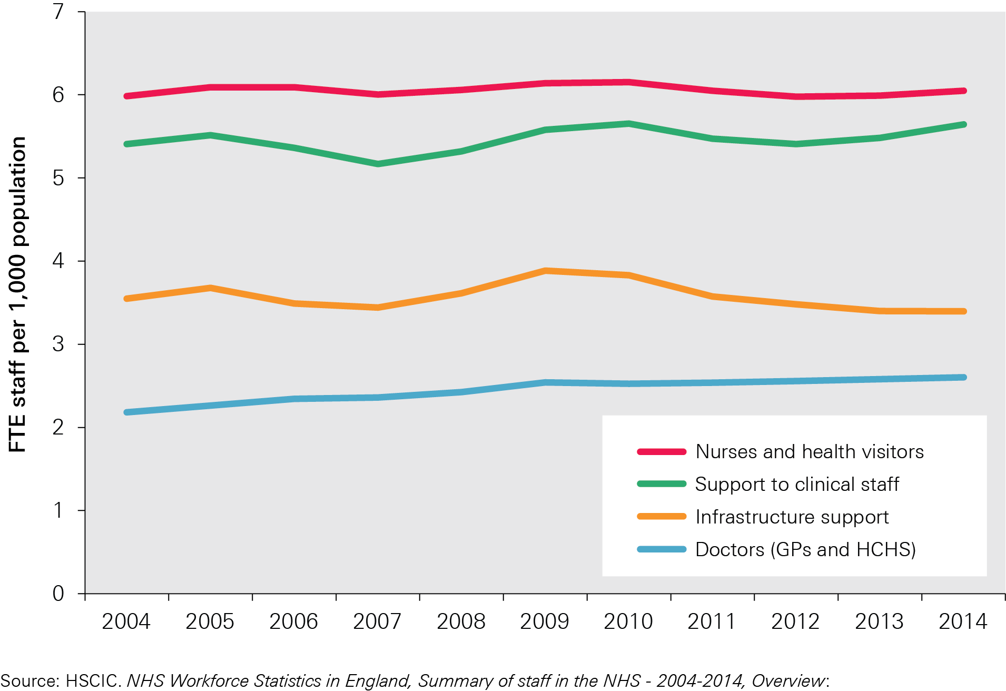
Figure K: Staff:population ratios, 2004–14

Slide 13
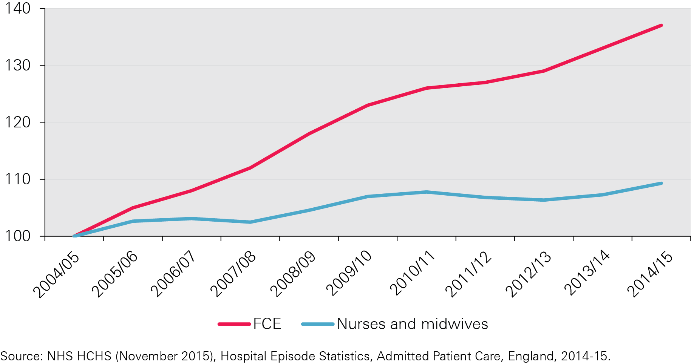
Figure L: Qualified nursing and midwifery staff and finished consultant episodes, NHS England, 2004/05–2014/15

Slide 14
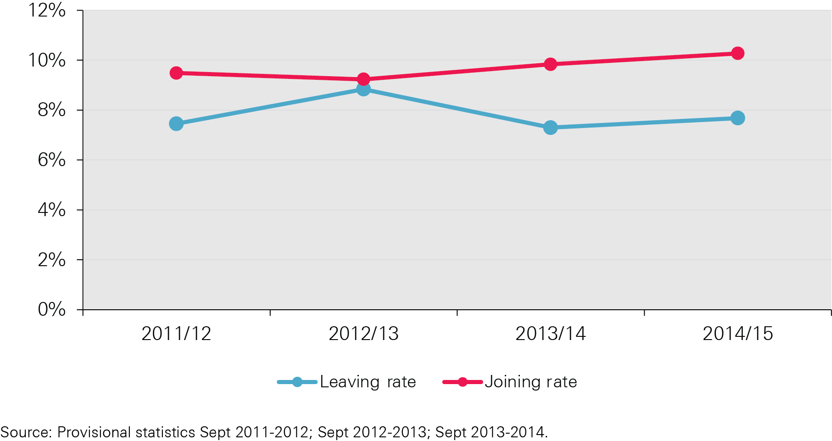
Figure M: Annual rate of HCHS doctors joining and leaving the workforce, 2011–15

Slide 15
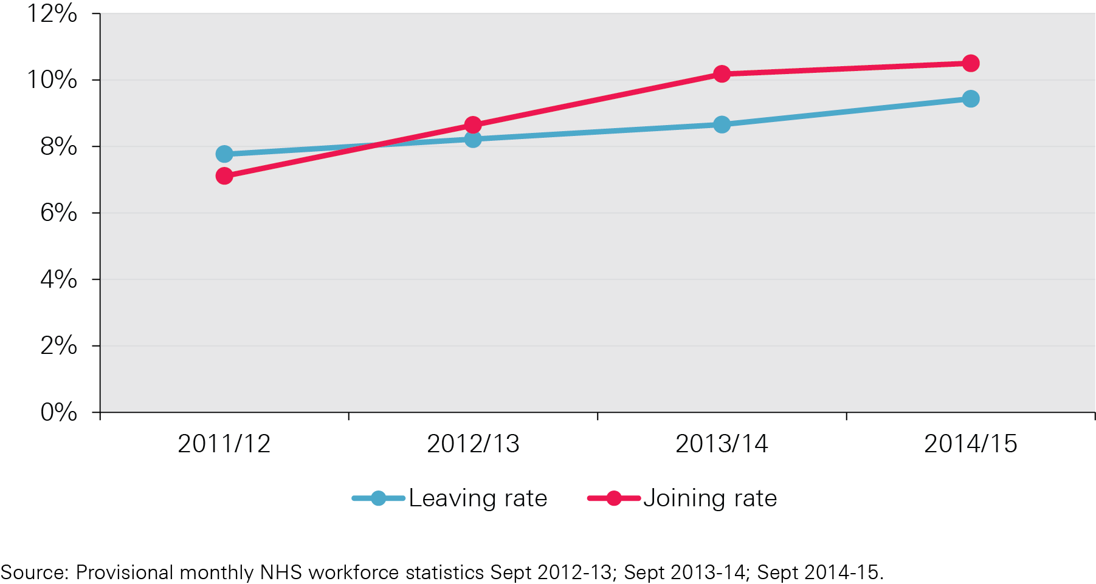
Figure N: Annual rate of qualified nurses, midwives and health visitors joining and leaving the workforce, 2011-2015

Slide 16
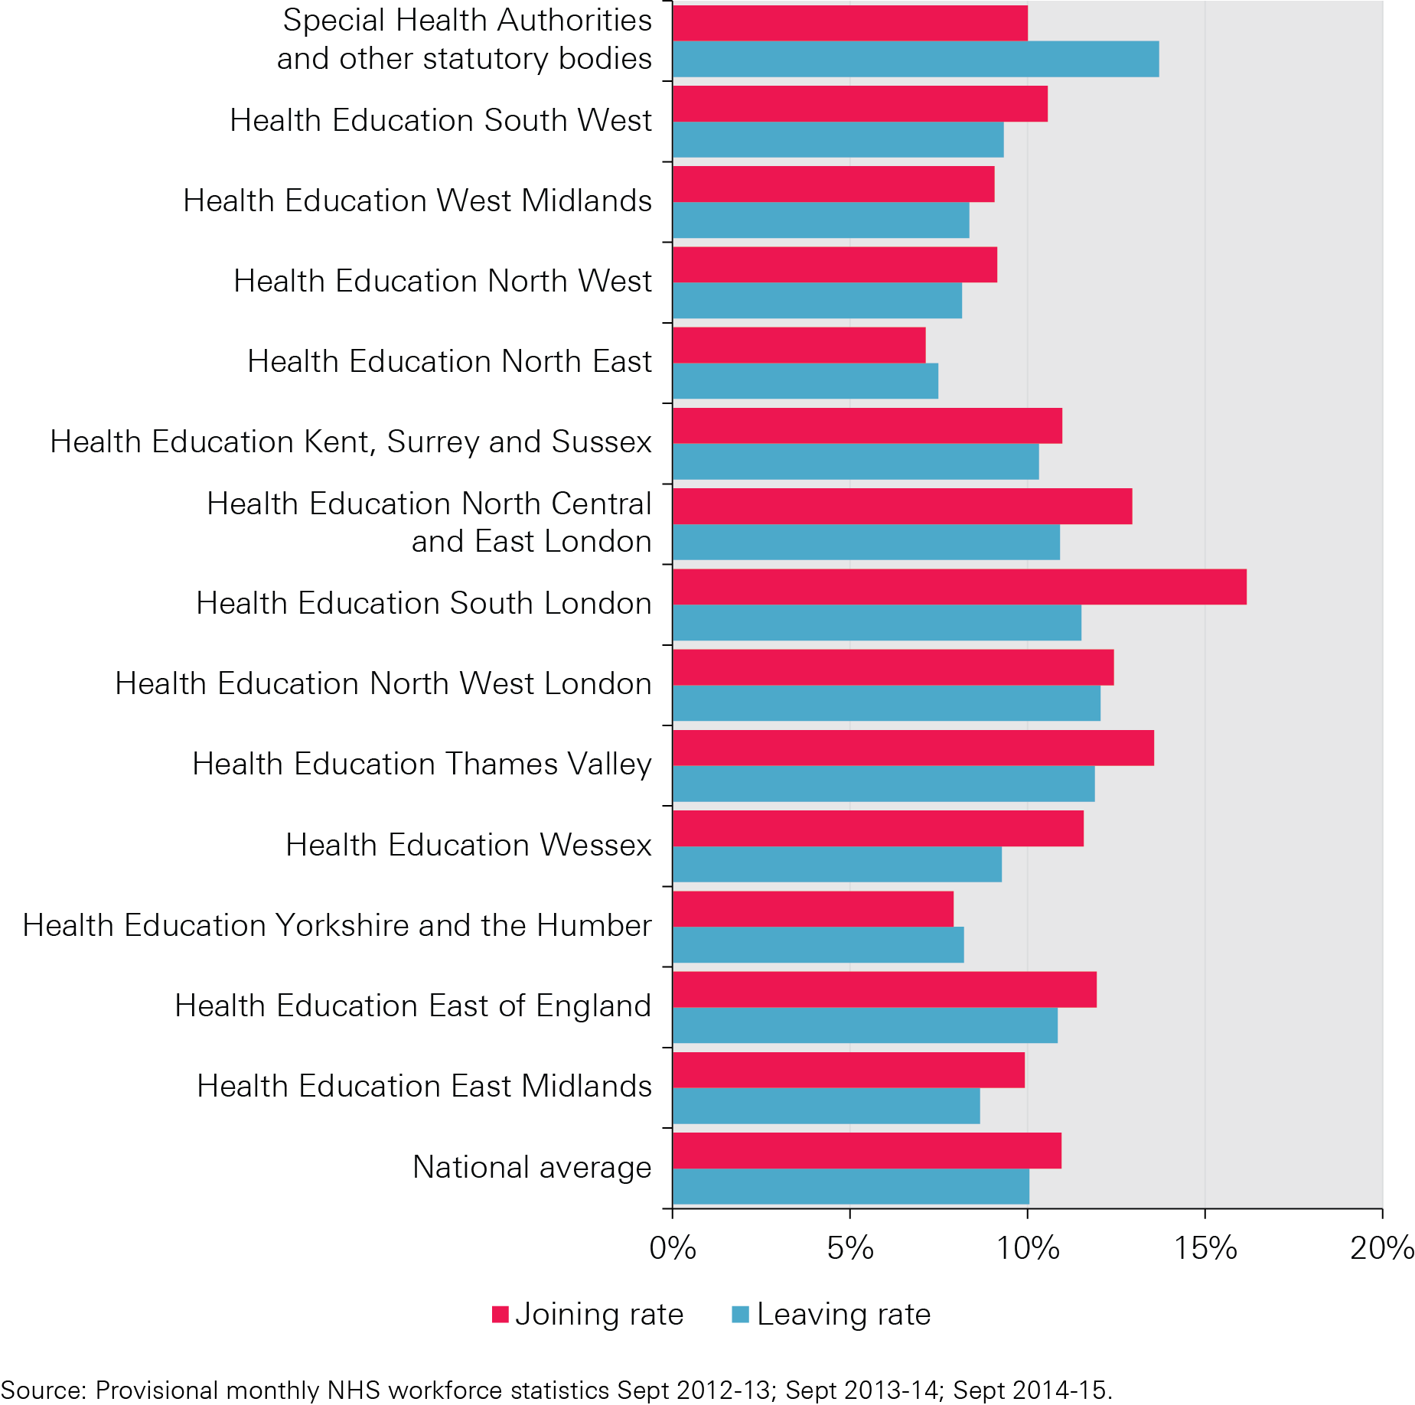
Figure O: Nurses joining and leaving the workforce (headcount) by HEE, 2014/15

Slide 17
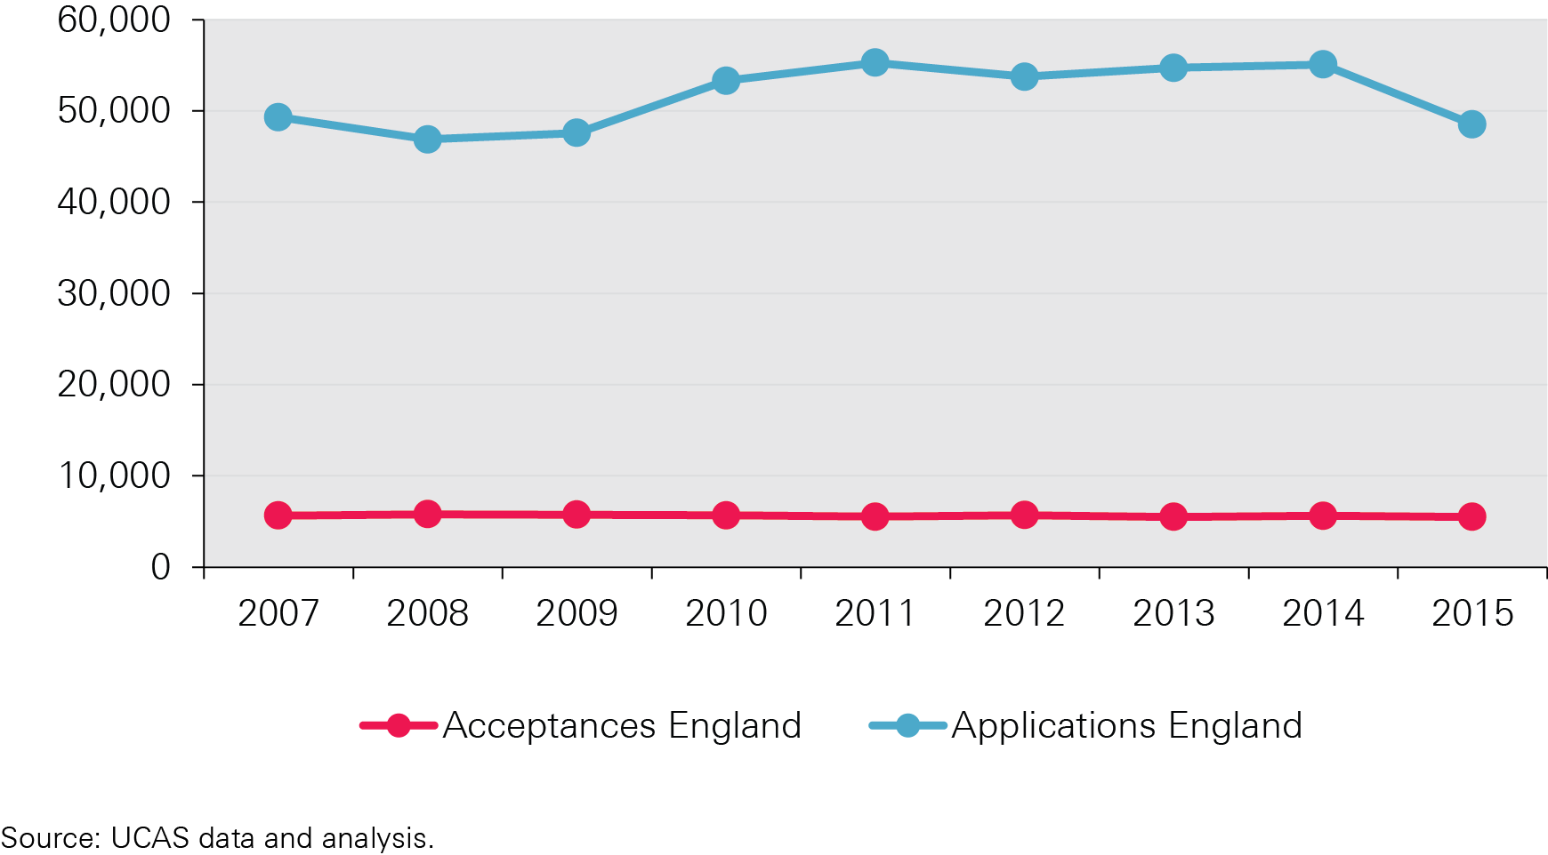
Figure P: Number of applications and acceptances for pre-clinical medicine training in England, 2007–15

Slide 18
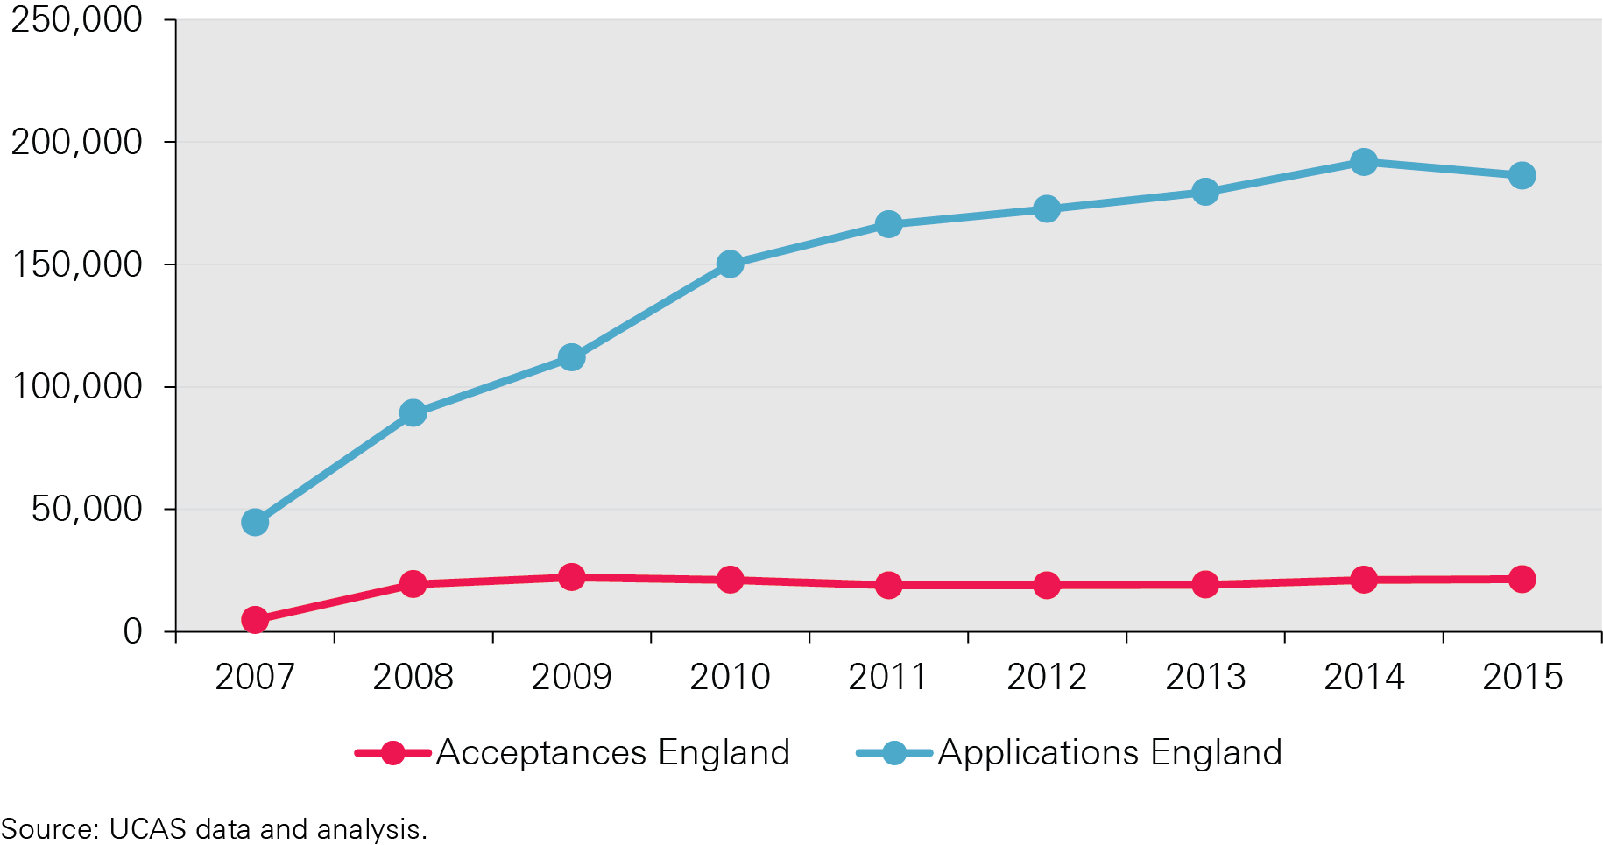
Figure Q: Number of applications and acceptances for nurse training in England, 2007–15

Slide 19
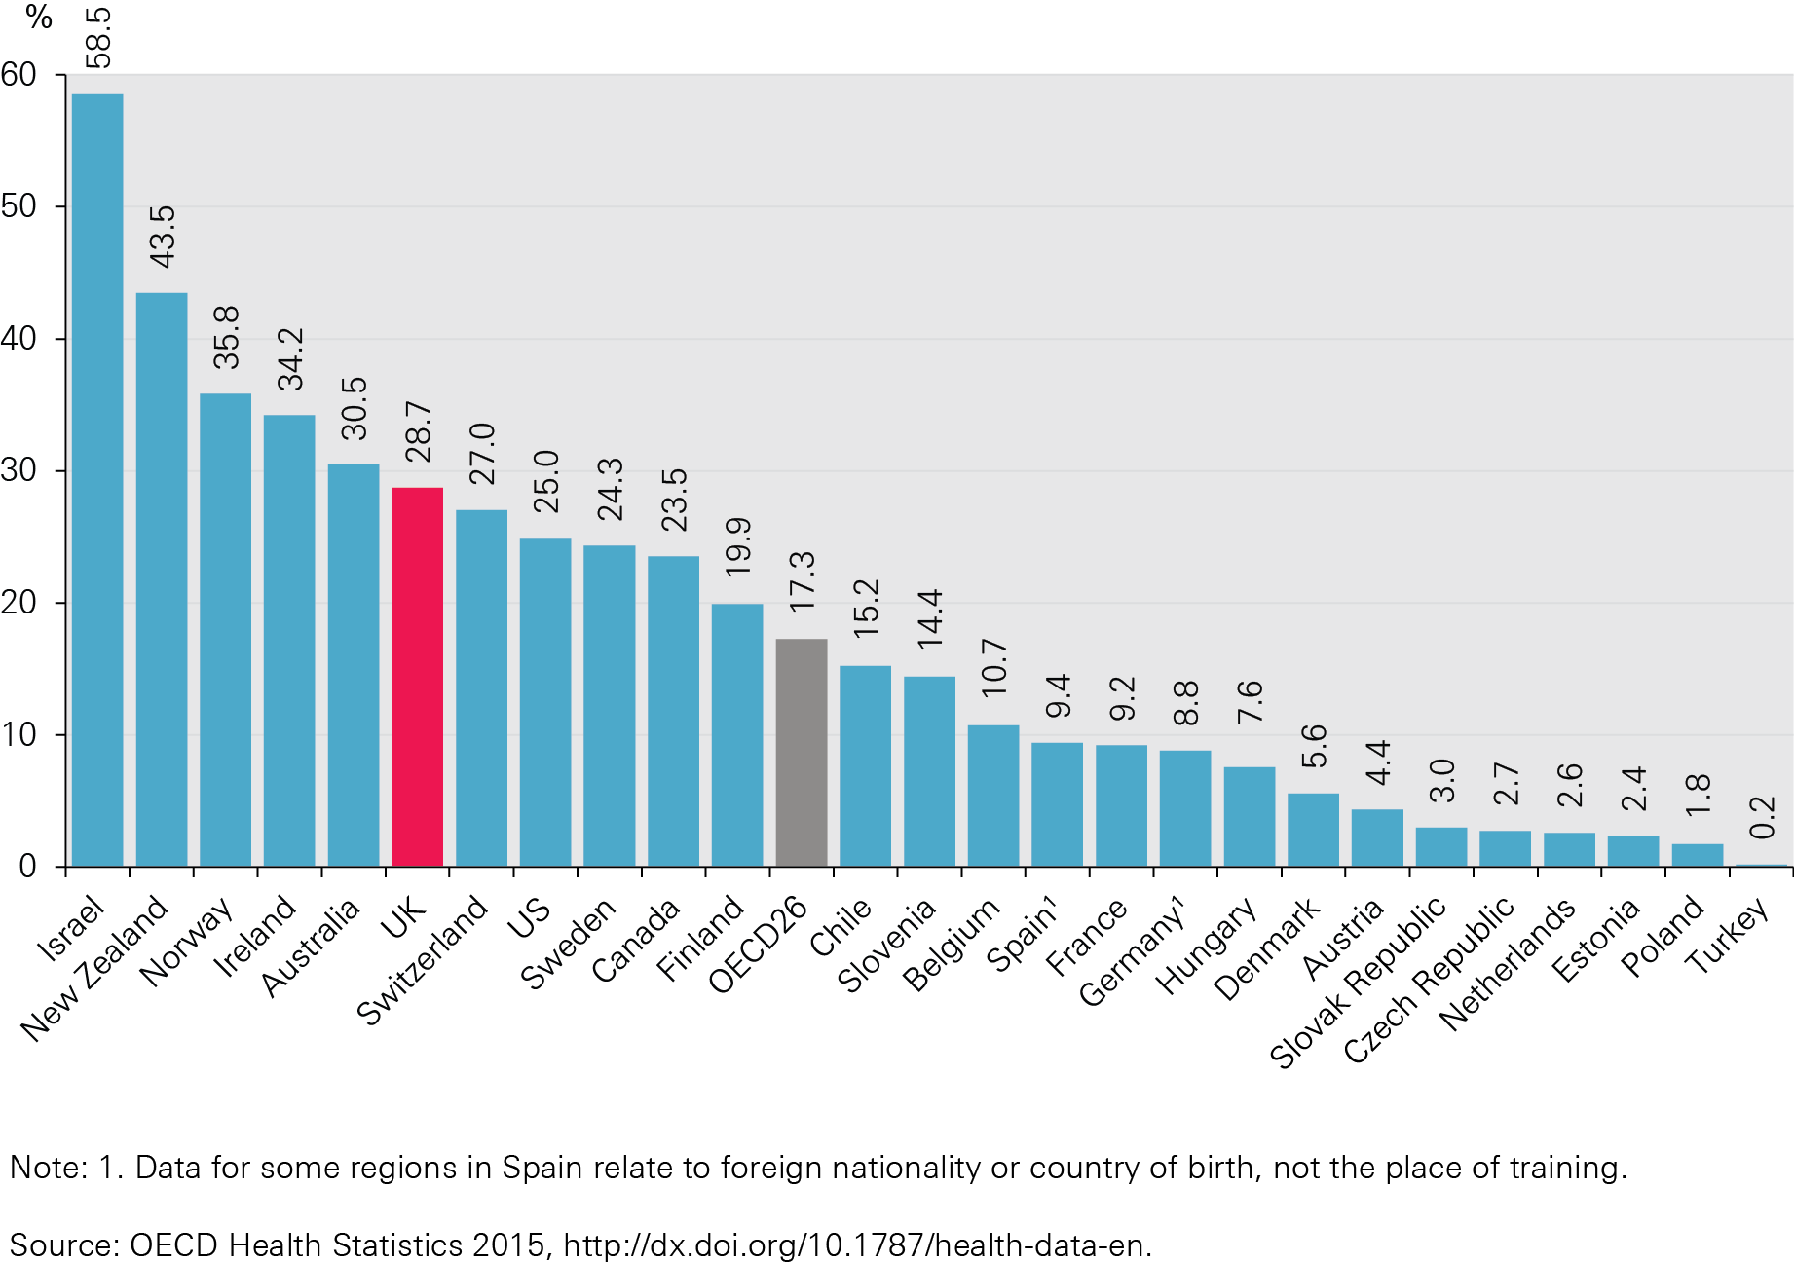
Figure R: Percentage of doctors who were foreign trained, 2013

Slide 20
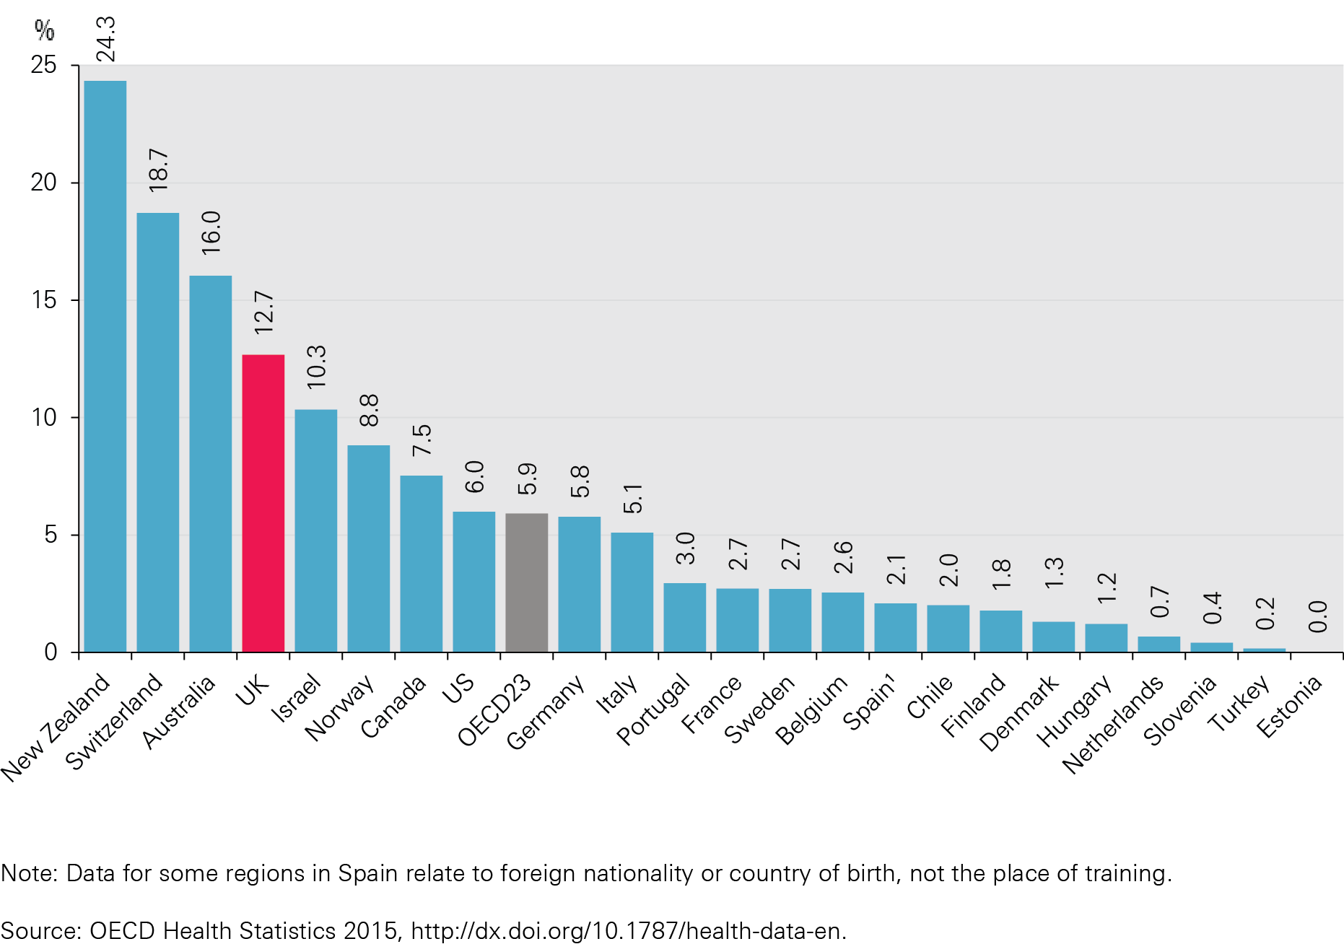
Figure S: Percentage of nurses who were foreign trained, 20132

Slide 21
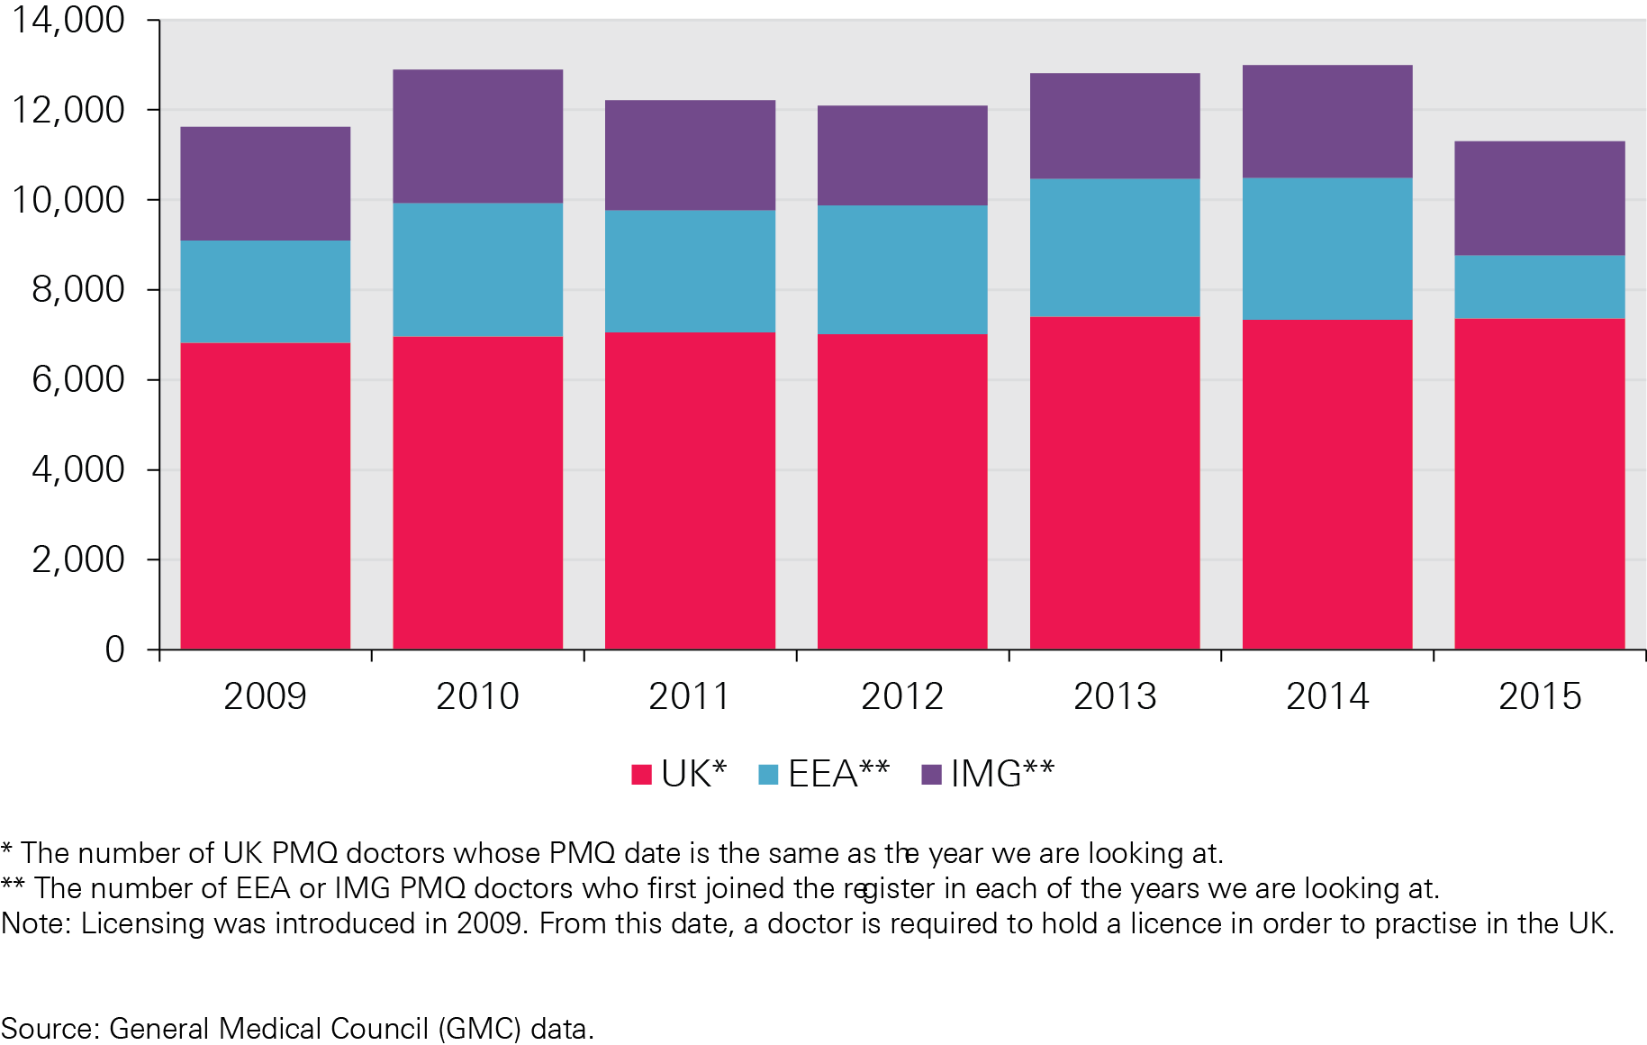
Figure T: Number of PMQ doctors on the GMC register with a licence to practise at year end, 2009–15

Slide 22
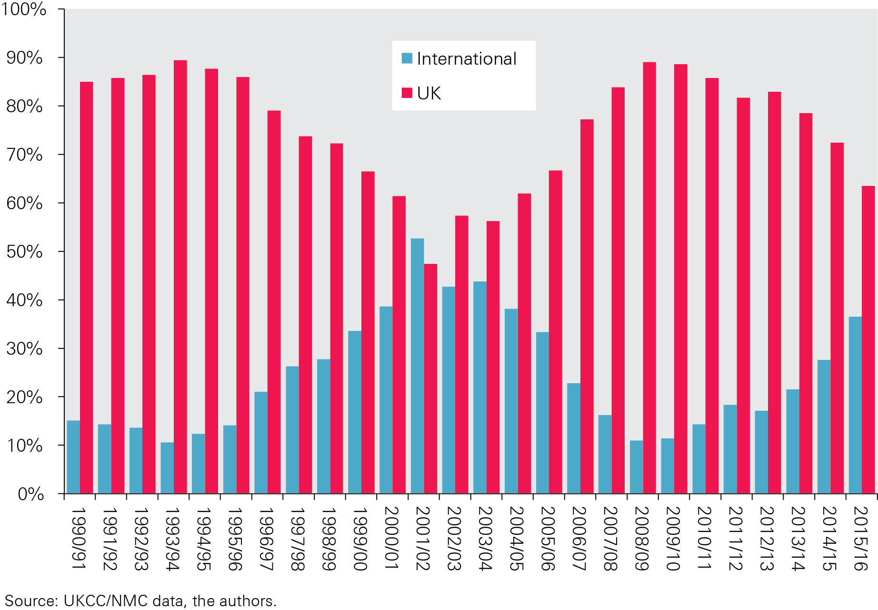
Figure U: International and UK sources as a % of total new admissions to the UK nursing register, 1990/91–2015/16 (initial registrations)

Slide 23
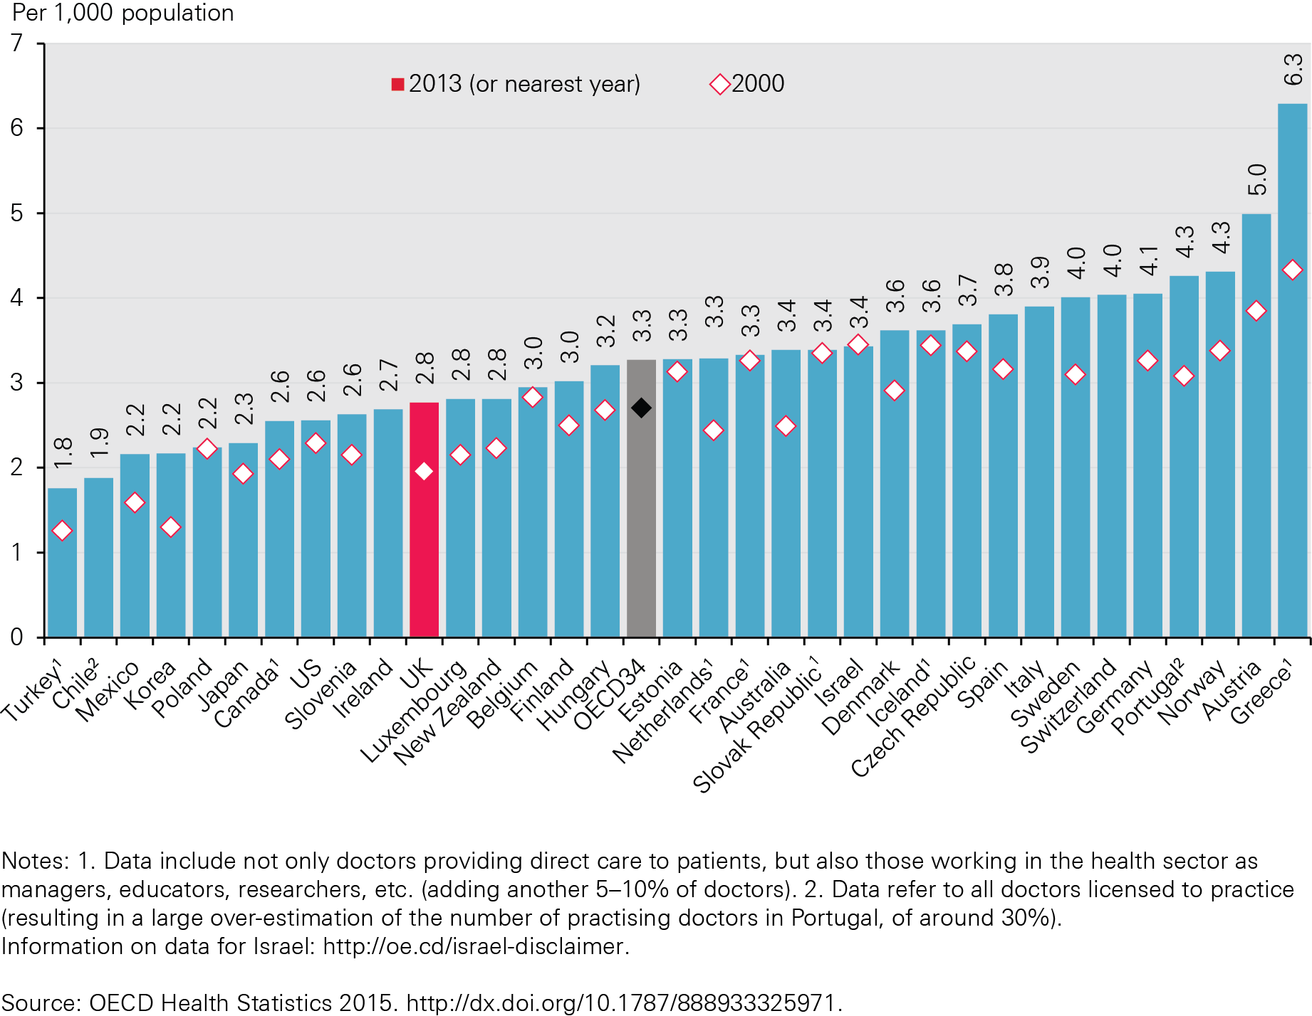
Figure V: Numbers of doctors per 1,000 population in OECD countries, 2000 and 2013 (or nearest year)

Slide 24
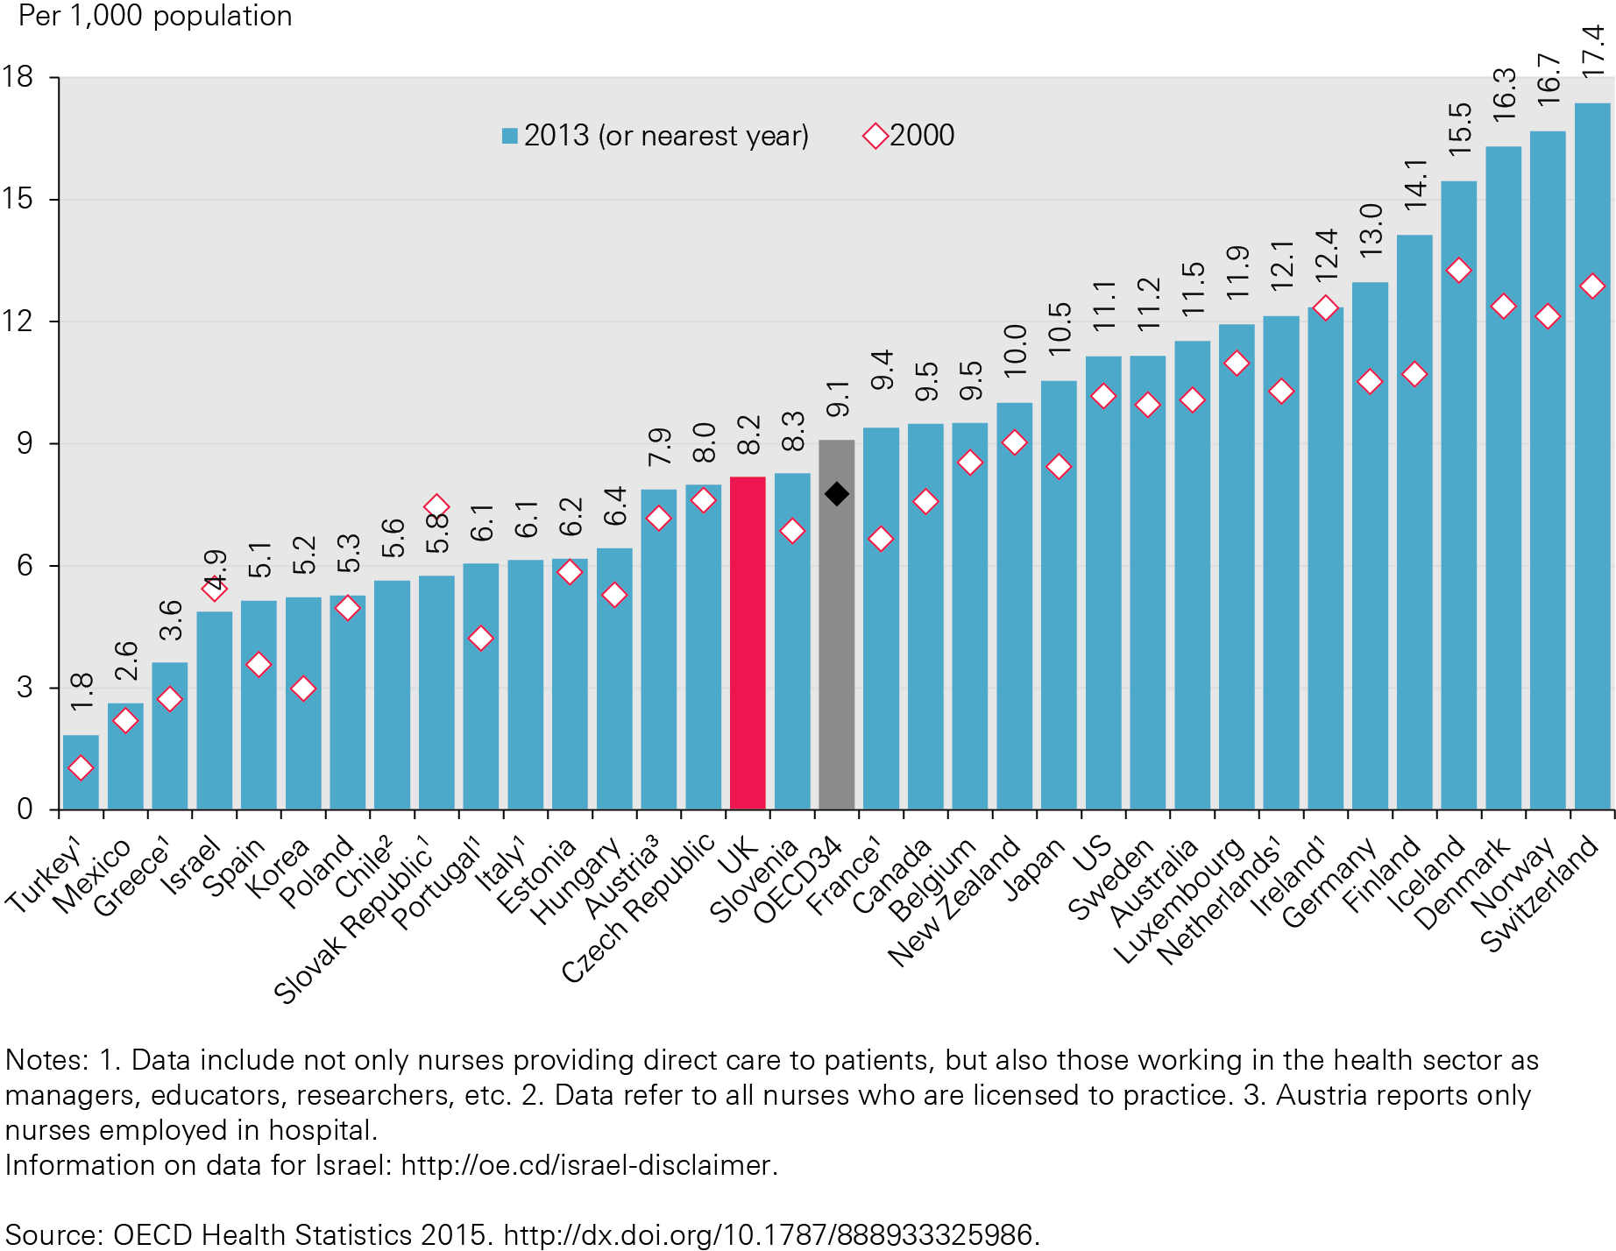
Figure W: Practising nurses per 1,000 population, OECD countries, 2000 and 2013 (or nearest year)6

Slide 25
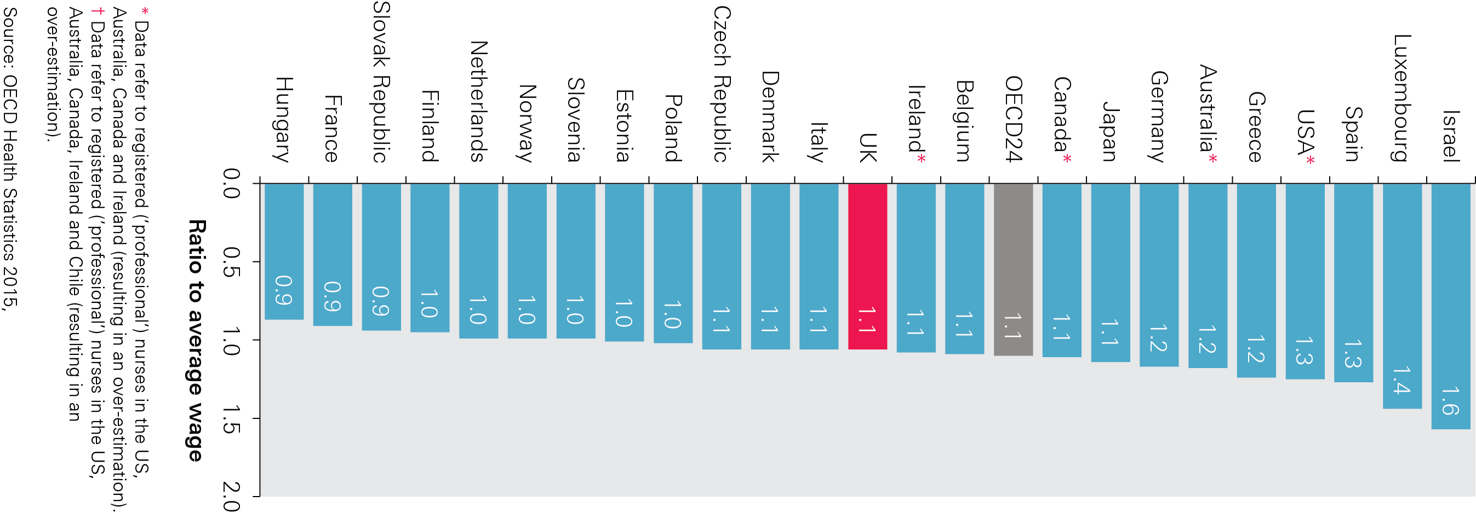
Figure X: Remuneration of hospital nurses, ratio to average wage, 2013 (or nearest year)

Slide 26
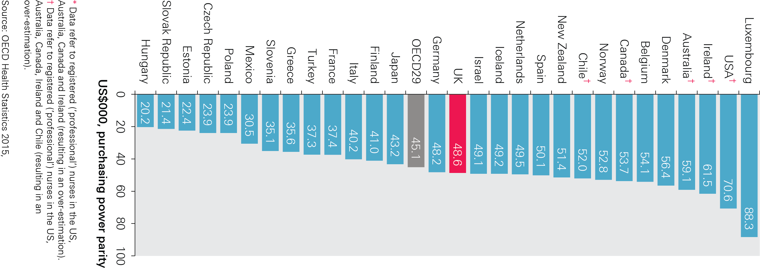
Figure Y: Remuneration of hospital nurses, US$000 purchasing power parity, 2013 (or nearest year)

Slide 27
The Health Foundation is an independent charity committed to bringing about better health and health care for people in the UK.
We connect what works on the ground with effective policymaking and vice versa.

Slide 28
Subscribe to our email newsletter
Register for email alerts to be notified about our latest work
Follow us on Twitter, Facebook, YouTube or LinkedIn

