Slide 1
DAWN – Diabetes Appointments via Webcam in Newham
Care from home –
Logo designed by
Karen O’Leary,
Service User
J Morris, T O’Shea, S Maddin, S Patel, M W Gill, S Vijayaraghavan
Partners: NHS Choices, Newham Community and Health Care Services / EFLT, Newham GP Commissioning, NE London Sector and Acute Commissioning Unit
Funded by:
Our support consultant:

Slide 2
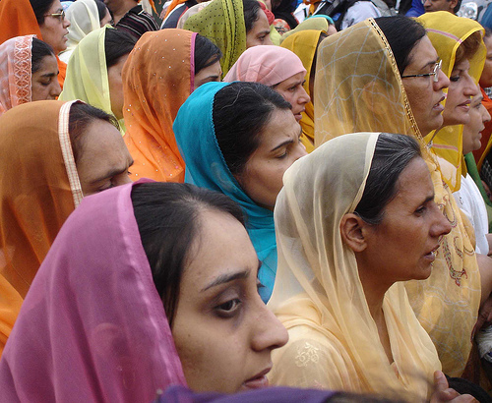
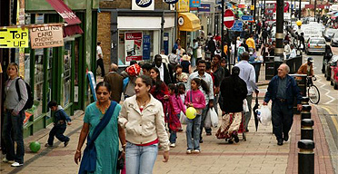
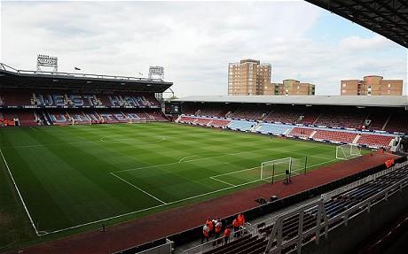
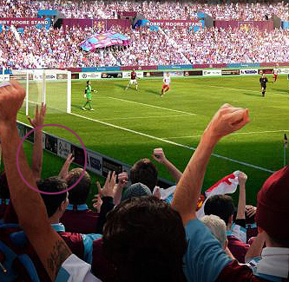
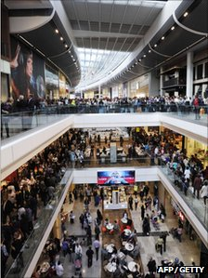
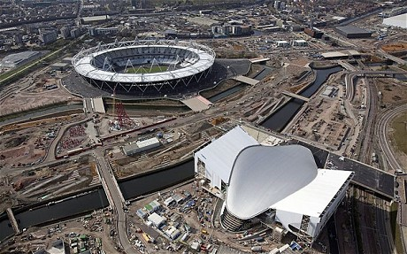
Newham – a place of contrasts

Slide 3
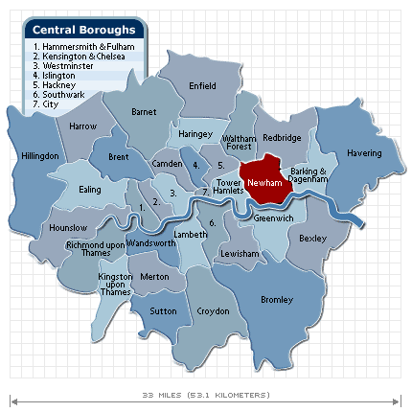
The local population
Borough of Newham (GLA projections)
302,500 (2012)
Approx. 70% from BME groups, 2008 (South Asian ethnic groups being 33%)
6thmost deprived borough in England
Approx. 40% aged 25 and under (compared to 30% for London)
Diabetes prevalence 9.4%, 3-4 times national average
Rising prevalence of T2DM in the young, mainly associated with obesity
2012 – Olympic Borough!

Slide 4
The problem
Newham Diabetes service exemplifies challenges within NHS:
Rising demand on services: estimated rise 13.5% in 2030
Pressure to cut costs/ improve efficiency
Inflexible and inaccessible services
High non attendance rates: e.g. approx 50% in the Young Adult clinic
Poor patient self-management, related to poor engagement with service and lack of flexibility of services (Local MORI survey ‘09)
Poor health outcomes
Repeat admissions via the emergency department, particularly for young adults
Poor blood glucose control: only 61.6% patients had hba1c ≤ 7.5 in last 15 months, 66.31% nationally
Increasing referrals to other services – renal, cardiac, foot care
Notes:
Decided not to say much about the exicting need because I am sure you are all very familiar with the rising pressure for more efficient and effective services and more services
particularly high DNA rates (33-50% for Diabetes, depending on age) reflecting the complex lives and access challenges of many local patients, largely from minority ethnic groups (61% population).

Slide 5
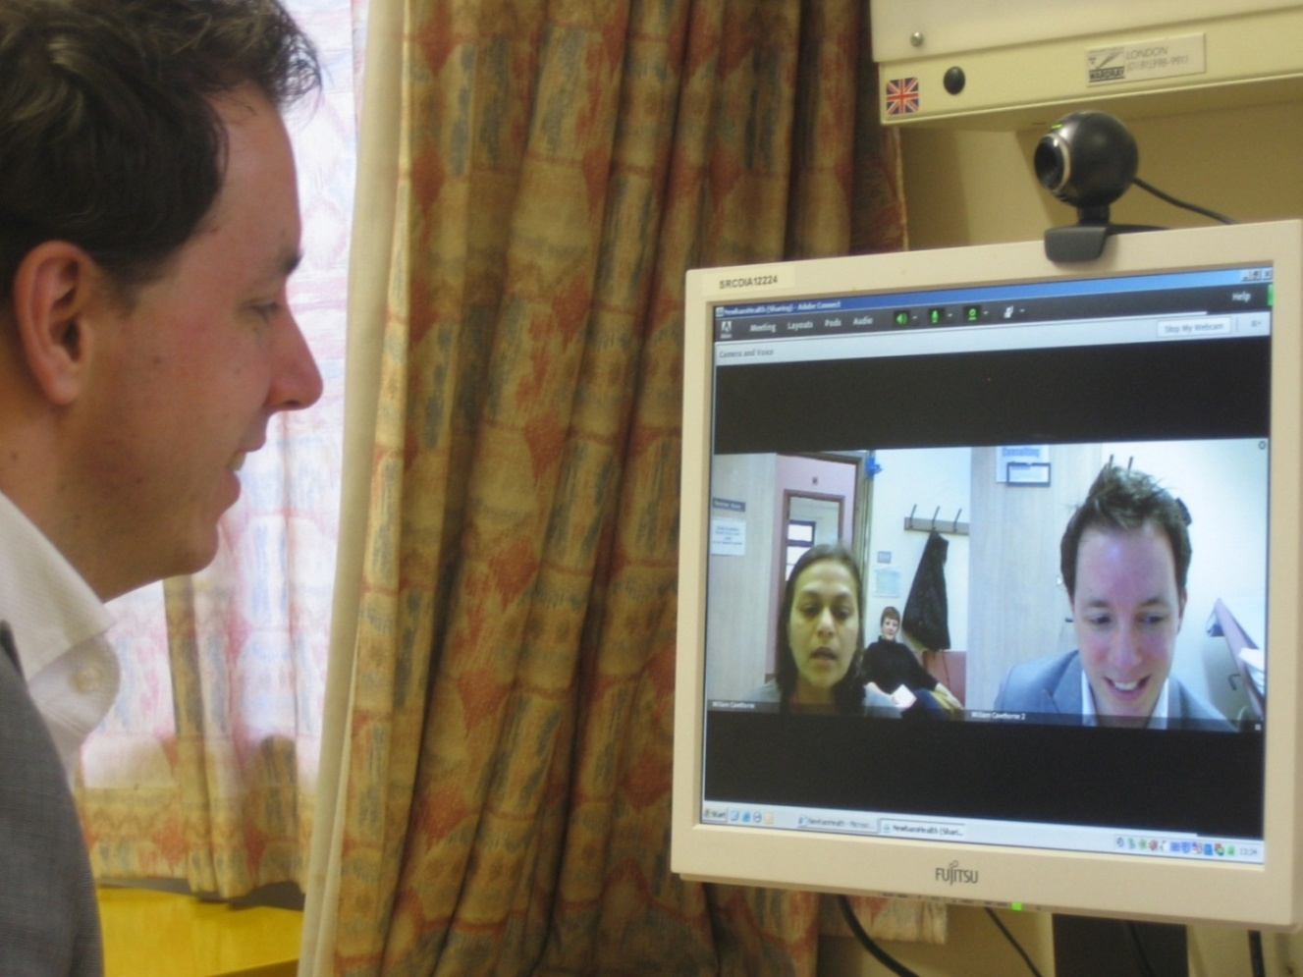
DAWN - Diabetes Appointments via
Webcam in Newham
Aim:
Learn IF and HOW web-based consultations can provide more accessible and cost-effective care in the diabetes department; using readily available, affordable technology
Webcam
Scope:
Offer online consultations to all patients, where clinically appropriate and where examination not required, under care of one consultant and one nurse specialist (from May 11), within the existing clinic
Include all ages
Evaluate using quantitative and qualitative methods

Slide 6
Recruitment (end Feb’12)
Out of 179 patients: 143 were considered clinically suitable (80%) and 89 patients agreed to participate (overall uptake of 62%)
Age of those who agreed to participate (excluding those considered clinically unsuitable):
Main reasons for NOT participating were: no access to the internet at home (52%), ‘prefer face to face’ (18.5%), not confident with the internet /computer (9%)
Patient ages | Number asked | Number accepted | % agreed
Under 50 | 91 | 75 | 82%
50 - 59 | 11 | 7 | 64%
60 - 69 | 14 | 4 | 29%
70 – 79 | 19 | 2 | 11%
Total | 143 | 89 | 62%

Slide 7
What did patients think?
19 in-depth telephone interviews, 1 focus group
28 completed on-line questionnaires
Main themes:
Convenience; saving time & money
average of 1.8hrs saved each appt
More likely to keep webcam appointments
15 of 28 (3 would be less likely)
Much prefer webcam appointments
19 of 28 (1 preferred face to face)
Quality of care same as face to face
27 out of 28
5. Feel more in control
Feel more comfortable talking to a Dr/nurse who they already know
Need a balance of face to face and webcam appointments
Barriers to attending initial appointments – adapting to change
“turned up at clinic instead”
“can’t remember the discussion about it”

Slide 8
Hard data: early results
1. Clinic ‘do not attend’ rates for webcam appointments
 | Number of webcam appointments | Number of DNAs (‘do not attends’) | DNA rates
Overall | 168 (68 patients) | 46 | 27%
Software provider 1 | 137 | 41 | 30%
Software provider 2 (Skype) | 31 | 5 | 16%
2. Emergency Department (ED) attendance, initial promising results
Baseline data: 12 diabetes related A&E attends, by webcam patients (7 patients), in year prior to webcam appointments
Follow up data: 0 attends so far since starting webcam appointments (average of 6 months of follow up data per patient). More data required.
3. Clinical outcomes measures, initial promising results
Of the 13 patients who had >2 webcam appointments, the average hba1c reduction was 2.91%, suggesting greater compliance with medication and self-management

Slide 9
Key Learning
Patients much preferred webcam appointments & say they are more likely to attend, generalisable across ages and ethnicity
3. You need time to demonstrate hard quantifiable benefits:
To gather sufficient data to draw conclusions
Transition time as patients move to new system; before they start to rely on it and use it to it’s full potential
4. Choice of software provider is important - ease of use and reliability of system matters
5. A flexible approach will maximise the potential of webcam consultations e.g. video phone and ad-hoc consultations may have the greatest impact
6. Efficiency savings:
Quick wins: shorter more focused consultations (increased capacity), savings for patients
Early findings suggest DNAs and A&E attends will reduce with time, with associated cost benefits
Greater efficiencies with increasing volume of web-consults, allowing web appointments to be grouped together with release of clinic infrastructure costs

Slide 10
What next?
Expanding web-consultations and online support for the Young Adult diabetes service
Exploring web-based diabetes care within the merged Barts Health Trust
Working with corporate partners to embed web-consultations in clinical care – unsuccessful Shared Purpose bid!
Considering an NIHR grant proposal to address quantitative and qualitative outcomes of web-based care

Slide 11
Evaluation
Clinic activity data from local diabetes database and EPR (electronic patient record): ongoing recording of number of appointments, DNA rates & A&E attendances
Spreadsheet with record of each scheduled webcam appointment with outcomes, notes and learning, maintained by clinicians.
Clinical outcomes tracked over time (e.g. Hba1c) for patients with several web appointments
On-line questionnaires for patient feedback
Focus group and one–one interviews with subset of patients
Qualitative interviews with staff

Slide 12
Efficiency savings
Savings using current model
Initially modest:
1. Duration of appointments – more focused, shorter, appointments
Extra 1 to 2 patients booked into the consultant clinic; additional £9,440 / year for hospital
2. Savings for patients (mainly indirect) and wider society
In time:
3. Significant reduction in DNAs
4. Reduction in avoidable A&E attendance & related admissions
Far greater savings when implemented on a wider scale:
Potential reduction in health advocacy and transport costs
Reduction in costs through grouping together webcam appointments with release of clinic infrastructure costs
long term health improvement with reduction in demands on other services
NB: Minimal running costs. Set costs include: training, clinic restructure, communication with patients.

Slide 13
Efficiency savings
Initially modest early savings using current model
(estimate £14k / yr min from current model at current DNA and A&E attend rates), but far greater potential when implemented for longer and on wider scale. Once set up, cost of intervention minimal (set up: training, clinic restructure, communication with patients)
1. Duration of appointments – more focused, shorter, appointments
Extra 1 to 2 patients booked into the consultant clinic; additional £9,440 / year for hospital
2. Reduction in DNAs
If current Skype DNA rates continue at 16% across all patients, compared to average baseline rates of 31%; modest savings of potentially £3,290 / year for hospital
3. Reduction in avoidable A&E attendance & related admissions
If early findings continue, potential savings approx £1,464 / year. Excluding related hospital admissions
4. Savings for patients (mainly indirect) and wider society
As one patient said they only need to take a half hour of work now, compared to a whole morning previously
Far greater savings potential longer term & on a wider scale:
Potential reduction in health advocacy and transport costs
Reduction in costs through re-organisation of clinics: space, support staff, clinician time, travel time
Reduction in demands on other services through long term health improvement

