Slide 1
A critical moment:
NHS staffing trends, retention and attrition
February 2019

Slide 2
Change in full-time equivalent (FTE) staff groups in the NHS in England, hospital and community health sevices (HCHS), July 2017 to July 2018
Staff group | 2017 | 2018 | Change
Professionally qualified clinical staff of which: | 562,937 | 572,313 | 9,376 (1.7%)
Doctors | 107,482 | 110,622 | 3,140 (2.9%)
Nurses and health visitors | 281,363 | 282,661 | 1,298 (0.5%)
Midwives | 21,281 | 21,482 | 201 (0.9%)
Ambulance staff | 19,919 | 20,676 | 757 (3.8%)
Scientific, therapeutic and technical staff | 132,892 | 136,872 | 3,980 (3.0%)
Support for clinical staff of which: | 314,514 | 319,209 | 4,695 (1.5%)
Support to doctors, nurses and midwives | 243,472 | 246,060 | 2,588 (1.1%)
Support to ambulance staff | 14,796 | 15,299 | 503 (3.4%)
Support to scientific, therapeutic and technical staff | 56,246 | 57,849 | 1,603 (2.9%)
Scientific, therapeutic and technical staff | 132,892 | 136,872 | 3,980 (3.0%)
Part 1/2
Source: NHS Digital. NHS Hospital and Community Health Service (HCHS) monthly workforce statistics – July 2018, provisional statistics (2018).

Slide 3
Change in full-time equivalent (FTE) staff groups in the NHS in England, hospital and community health sevices (HCHS), July 2017 to July 2018
Staff group | 2017 | 2018 | Change
Support for clinical staff of which: | 314,514 | 319,209 | 4,695 (1.5%)
Support to doctors, nurses and midwives | 243,472 | 246,060 | 2,588 (1.1%)
Support to ambulance staff | 14,796 | 15,299 | 503 (3.4%)
Support to scientific, therapeutic and technical staff | 56,246 | 57,849 | 1,603 (2.9%)
NHS infrastructure support staff of which: | 165,252 | 169,348 | 4,096 (2.5%)
Central functions | 80,948 | 83,427 | 2,479 (3.1%)
Hotel, property and estates | 52,705 | 52,903 | 198 (0.4%)
Senior managers | 10,116 | 10,243 | 127 (1.3%)
Managers | 21,483 | 22,775 | 1,292 (6.0%)
Other/unknown | 4,125 | 4,525 | 401 (9.7%)
Total | 1,046,828 | 1,065,395 | 18,567 (1.8%)
Part 2/2
Source: NHS Digital. NHS Hospital and Community Health Service (HCHS) monthly workforce statistics – July 2018, provisional statistics (2018).

Slide 4
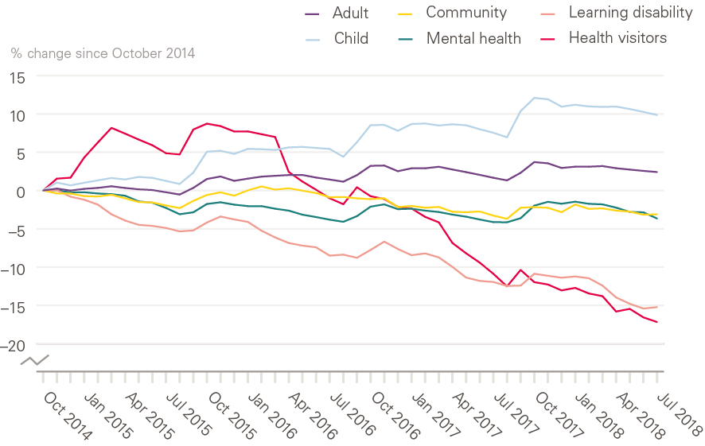
Change in nursing workforce by work area (HCHS) October 2014 to July 2018
Source: NHS Digital. NHS Hospital and Community Health Service (HCHS) monthly workforce statistics – July 2018, provisional statistics (2018).

Slide 5
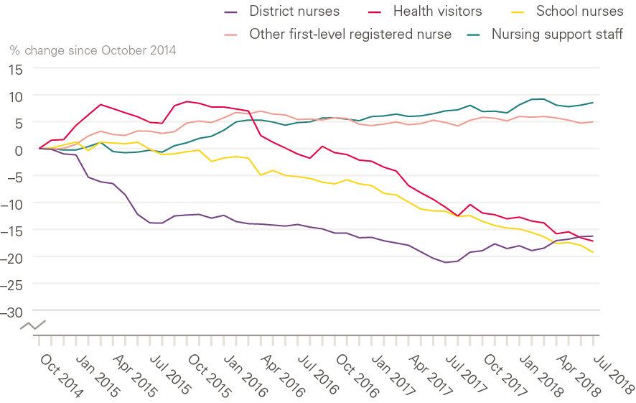
Change in community nursing and health visiting, selected occupations (HCHS), October 2014 to July 2018
Source: NHS Digital. NHS Hospital and Community Health Service (HCHS) monthly workforce statistics – July 2018, provisional statistics (2018).

Slide 6
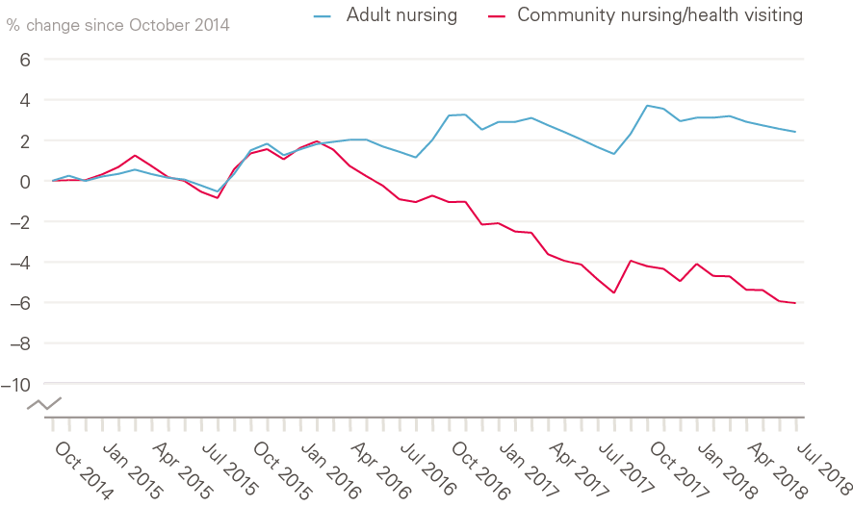
Change in adult hospital nursing and community nursing/health visiting in the NHS in England (HCHS), October 2014 to July 2018
Source: NHS Digital. NHS Hospital and Community Health Service (HCHS) monthly workforce statistics – July 2018, provisional statistics (2018).

Slide 7
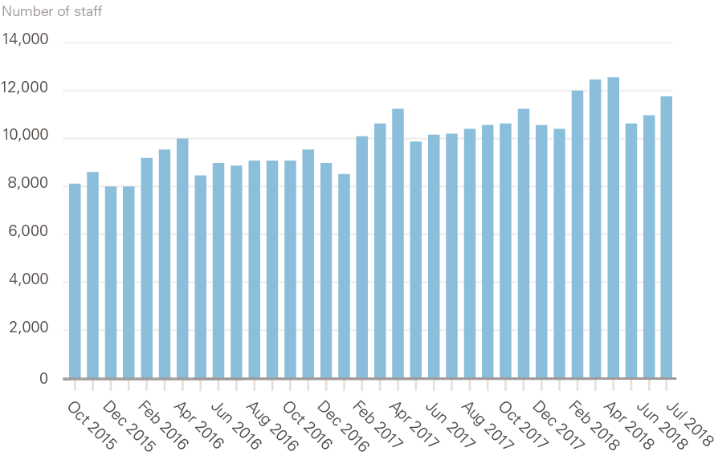
Nurses and health visitors working as bank staff (full-time equivalent) in the NHS in England (HCHS), October 2015 to July 2018
Source: NHS Digital. NHS Hospital and Community Health Service (HCHS) monthly workforce statistics – July 2018, provisional statistics (2018).

Slide 8
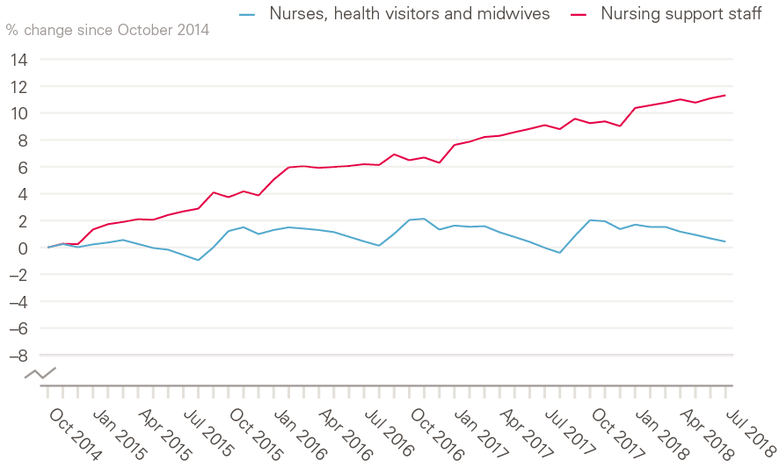
Change in registered nurses, health visitors, midwives and nursing support staff (full-time equivalent) in the NHS in England (HCHS), October 2014 to July 2018
Source: NHS Digital. NHS Hospital and Community Health Service (HCHS) monthly workforce statistics – July 2018, provisional statistics (2018).

Slide 9
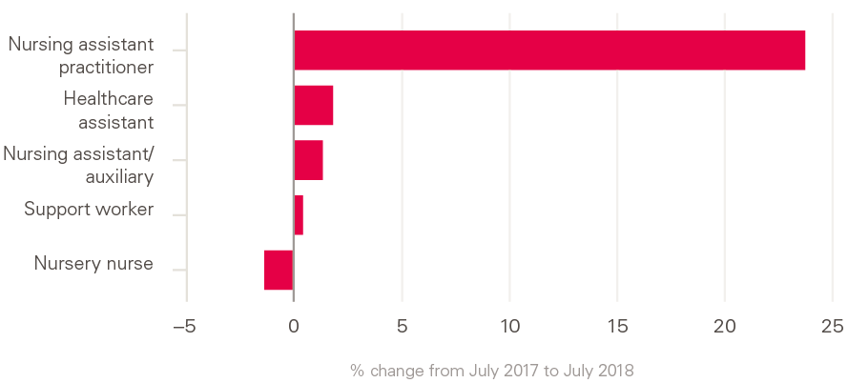
Change in nursing support staff (full-time equivalent) in the NHS in England (HCHS), July 2017 to July 2018
Source: NHS Digital. NHS Hospital and Community Health Service (HCHS) monthly workforce statistics – July 2018, provisional statistics (2018).

Slide 10
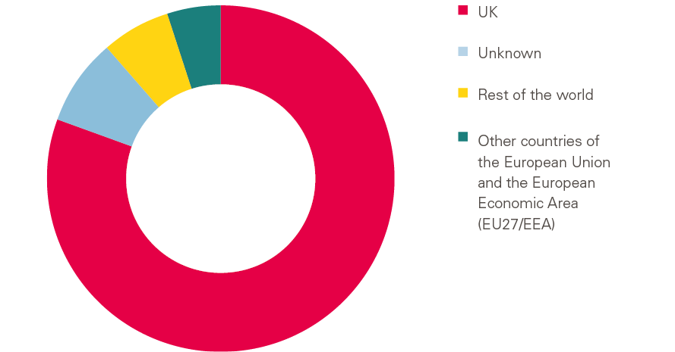
NHS health and community health service workforce by nationality
Source: NHS Digital. NHS Hospital and Community Health Service (HCHS) monthly workforce statistics – July 2018, provisional statistics (2018).

Slide 11
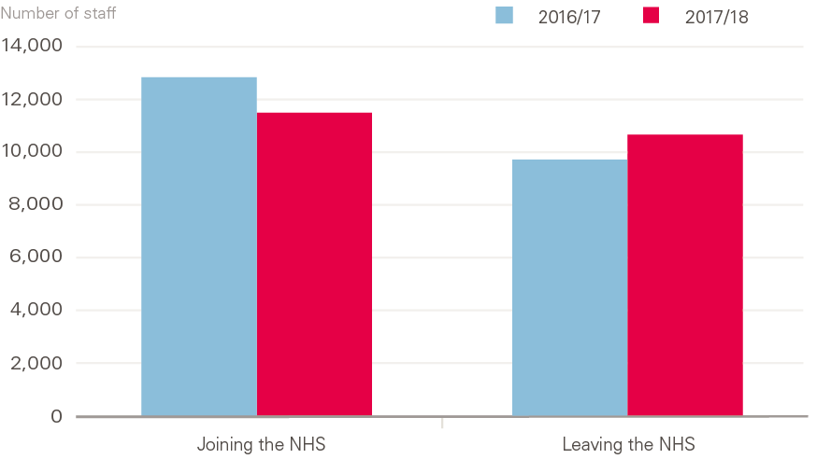
Flows of EU27 staff into and out of the NHS in England (HCHS) 2016/17 and 2017/18
Source: NHS Digital. NHS Hospital and Community Health Service (HCHS) monthly workforce statistics – July 2018, provisional statistics (2018).

Slide 12
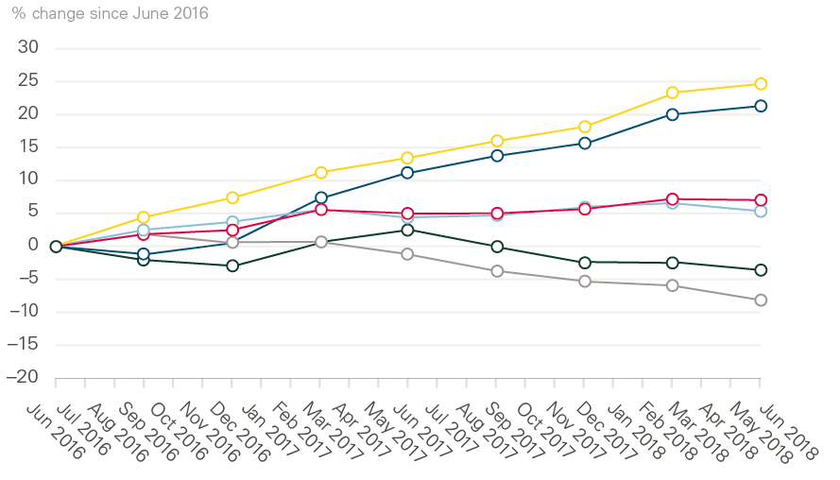
Change in patient care staff (full-time equivalent) in the NHS in England from EU27 states, HCHS, June 2016 to June 2018
Source: NHS Digital. NHS Hospital and Community Health Service (HCHS) monthly workforce statistics – July 2018, provisional statistics (2018).

Slide 13
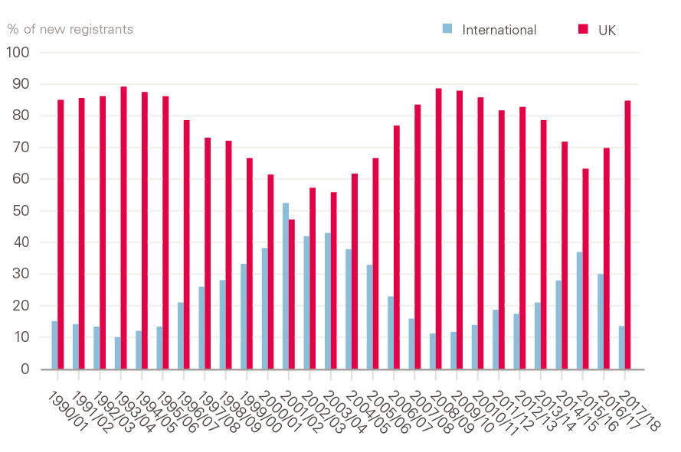
Annual intake of new registrants to the UK nursing register, 1990–2018
Source: Registration data from Nursing and Midwifery Council.

Slide 14
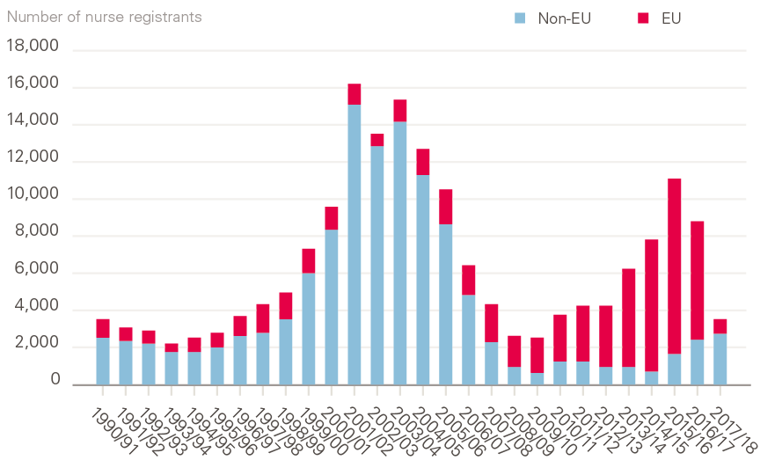
Annual intake of new EU and non-EU international registrants to the UK nursing register, 1990–2018
Source: Registration data from Nursing and Midwifery Council.

Slide 15
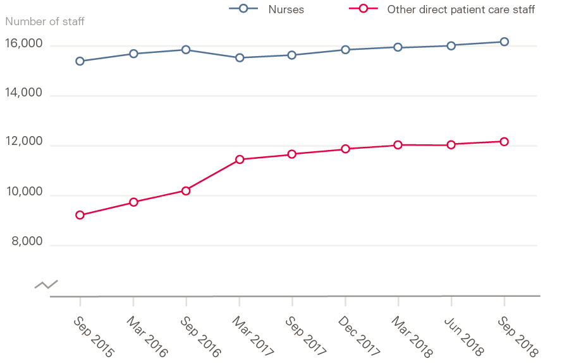
Nurses and other direct patient care staff (full-time equivalent) working in general practice, September 2015 to September 2018
Source: NHS Digital. General and Personal Medical Services England, GP Tables September 2018, Provisional Experimental Statistics (2018).

Slide 16
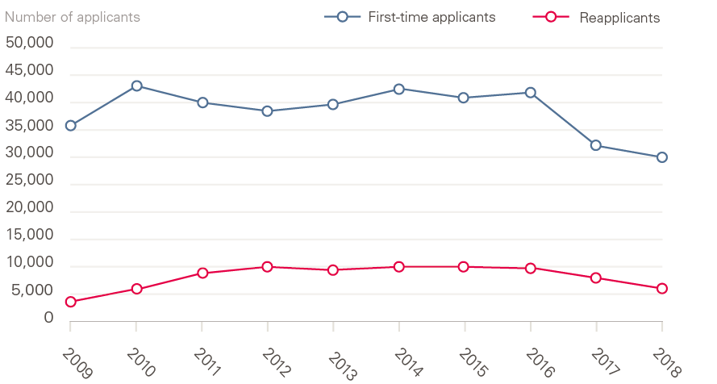
First-time applicants and reapplicants to undergraduate nursing degree courses in England, 2009–2018
Source: Universities and Colleges Admissions Service. 2018 Cycle Applicant Figures – June Deadline (2018).

Slide 17
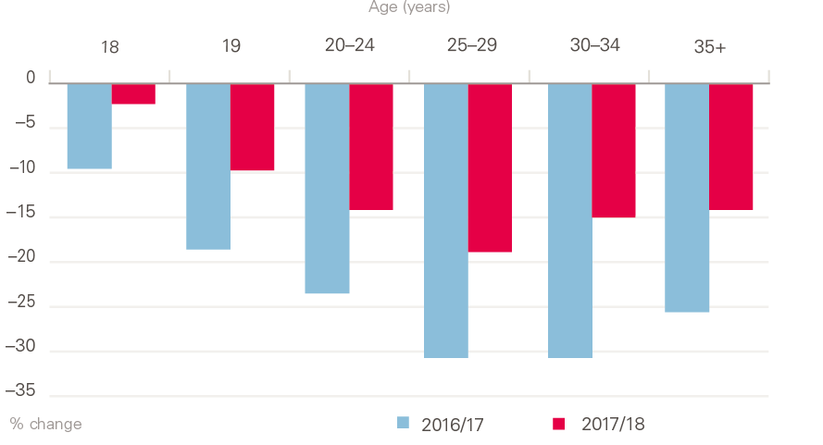
Change (%) in applicants to undergraduate nursing degree courses by age in England, 2016/17 and 2017/18
Source: Universities and Colleges Admissions Service. 2018 Cycle Applicant Figures – June Deadline (2018).

Slide 18
Number of placed applicants on UK university nursing courses by country of domicile 28 days after A-level results day, 2013–2018
Country of domicile | 2013 | 2014 | 2015 | 2016 | 2017 | 2018 | Change
England | 18,620 | 20,660 | 20,670 | 22,040 | 20,820 | 20,250 | –570 (–2.7%)
Northern Ireland | 910 | 940 | 950 | 1,100 | 1,070 | 1,050 | –20 (–1.9%)
Scotland | 2,640 | 2,970 | 2,950 | 2,950 | 3,200 | 3,340 | +140 (+4.4%)
Wales | 1,280 | 1,270 | 1,500 | 1,580 | 1,630 | 1,720 | +90 (+5.5%)
EU27 | 510 | 440 | 480 | 520 | 420 | 400 | –20 (–4.8%)
Other | 60 | 60 | 80 | 60 | 100 | 130 | +30 (+30.0%)
Total | 24,020 | 26,340 | 26,630 | 28,520 | 27,240 | 26,890 | –350 (–1.3%)
Source: Universities and Colleges Admission Service. Statistical Releases – Daily Clearing Analysis 2018 (20 September 2018).

Slide 19
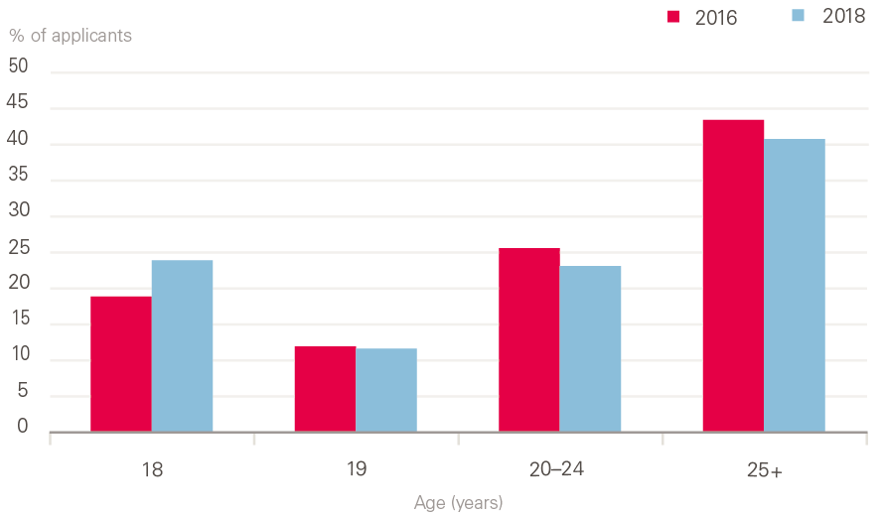
Age profile of placed applicants on nursing courses in England 2016 and 2018
Source: Universities and Colleges Admission Service. Statistical Releases – Daily Clearing Analysis 2018 (20 September 2018).

Slide 20
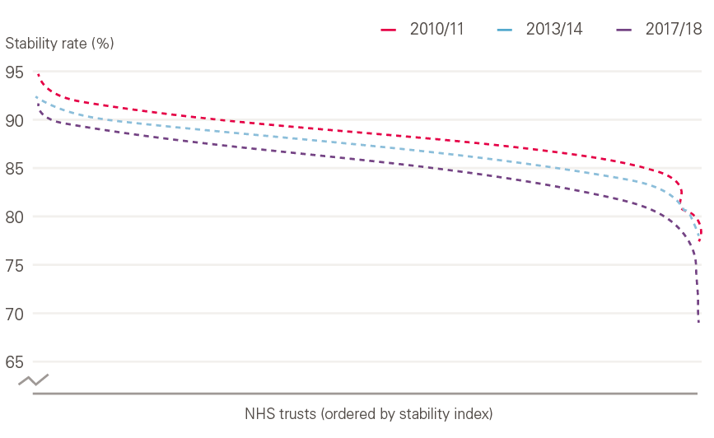
Stability rates of NHS trusts in England 2010/11 to 2017/18
Source: Health Foundation analysis of NHS Digital data.

Slide 21
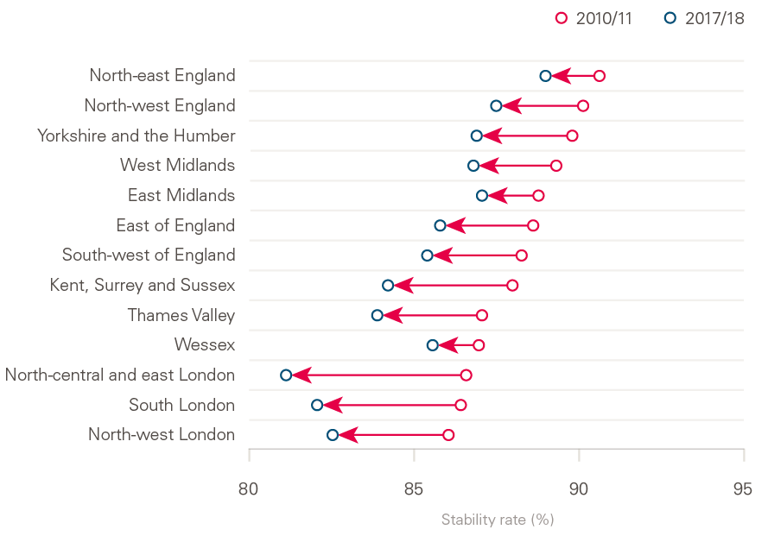
Regional-level NHS trust stability-rate, 2010/11 and 2017/18
Source: Health Foundation analysis of NHS Digital data.
Note: Excludes doctors in training.

Slide 22
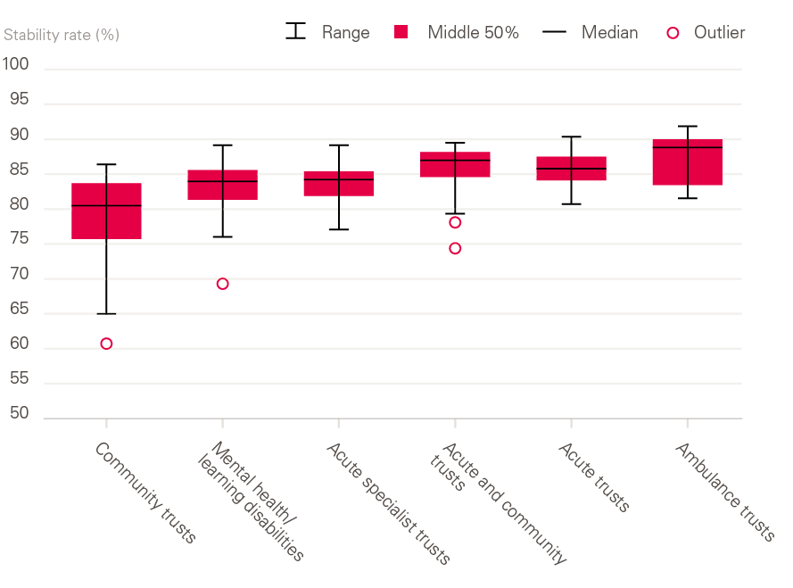
Difference in stability of NHS trusts by trust type, 2017/18
Source: Health Foundation analysis of NHS Digital data.

Slide 23
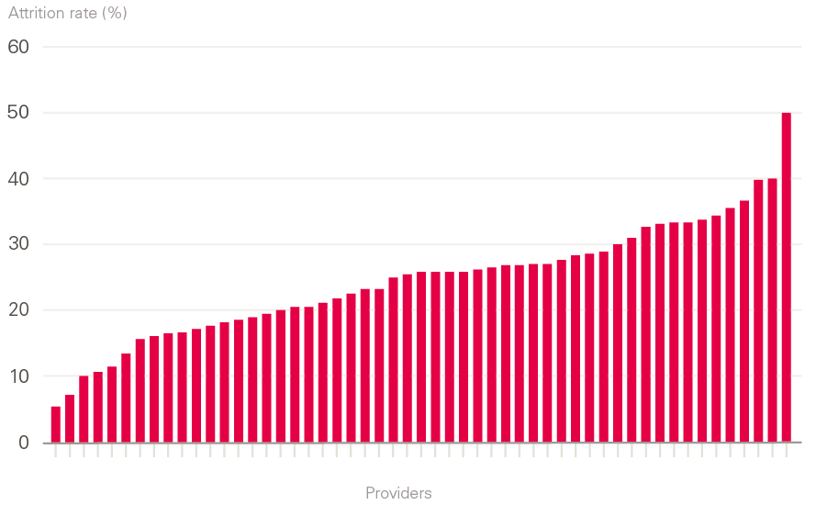
Student attrition rate during a 3-year nursing degree by provider 2014–2017
Source: Data obtained directly from universities via Freedom of Information requests.

