Slide 1
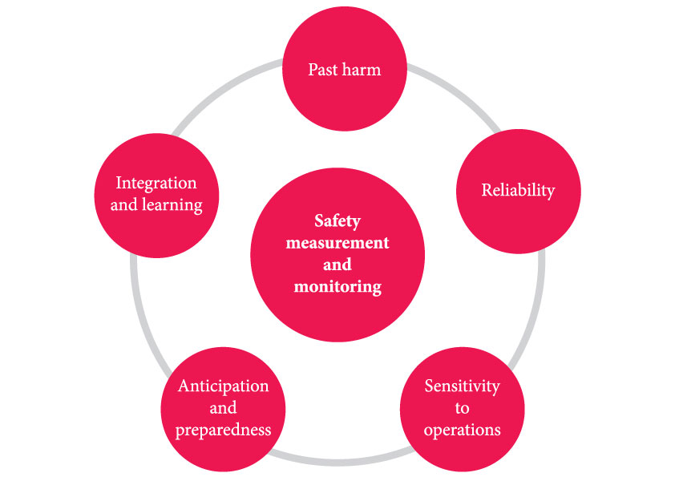
A framework for the measurement and monitoring of safety
Source: Vincent C, Burnett S, Carthey J. The measurement and monitoring of safety. The Health Foundation, 2013.
www.health.org.uk/publications/the-measurement-and-monitoring-of-safety

