Slide 1
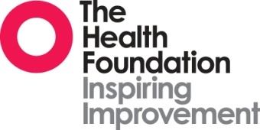
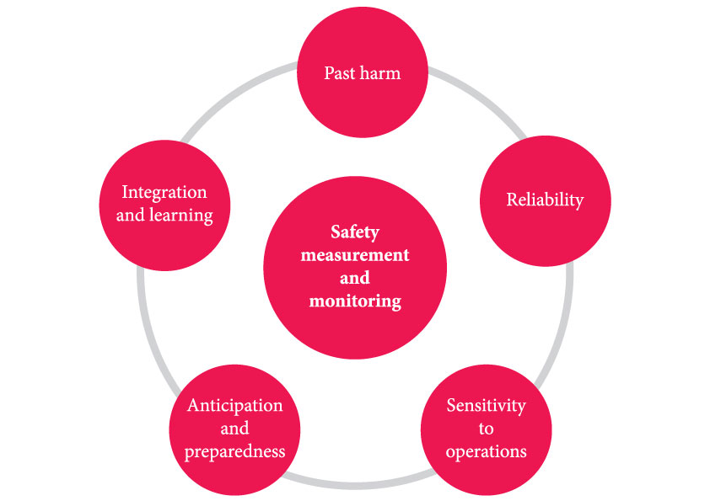
A framework for the measurement and monitoring of safety
Has patient care been safe in the past?
Ways to monitor harm include:
mortality statistics (including HSMR and SHMI)
record review (including case note review and the Global Trigger Tool)
staff reporting (including incident report and ‘never events’)
routine databases.
Are we responding and improving?
Sources of information to learn from include:
automated information management systems highlighting key data at a clinical unit level (e.g. medication errors and hand hygiene compliance rates)
at a board level, using dashboards and reports with indicators, set alongside financial and access targets.
Are our clinical systems and processes reliable?
Ways to monitor reliability include:
percentage of all inpatient admissions screened for MRSA
percentage compliance with all elements of the pressure ulcer care bundle.
Will care be safe in the future?
Possible approaches for achieving anticipation and preparedness include:
risk registers
safety culture analysis and safety climate analysis
safety training rates
sickness absence rates
frequency of sharps injuries per month
human reliability analysis (e.g. FMEA)
safety cases.
Is care safe today?
Ways to monitor sensitivity to operations include:
safety walk-rounds
using designated patient safety officers
meetings, handovers and ward rounds
day-to-day conversations
staffing levels
patient interviews to identify threats to safety.
Source: Vincent C, Burnett S, Carthey J. The measurement and monitoring of safety. The Health Foundation, 2013

